Slide 1
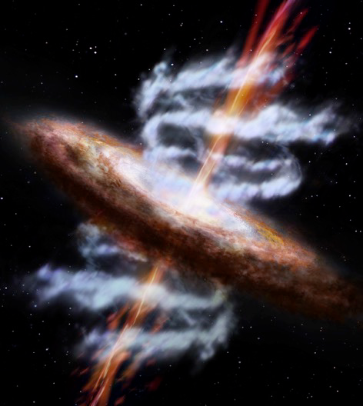
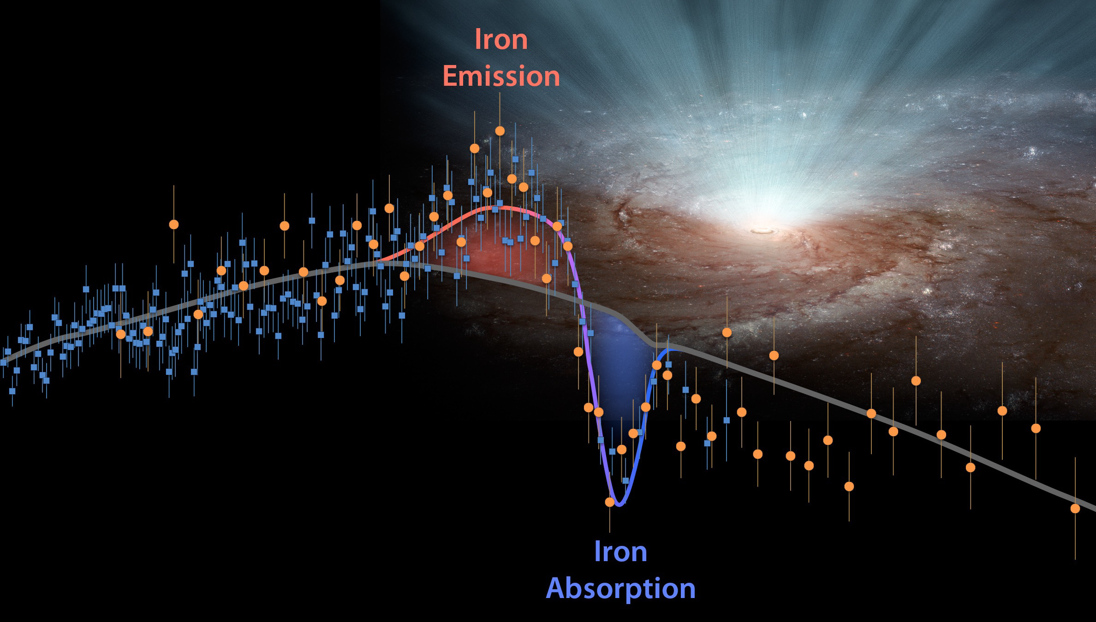
Radio structures in radio-quiet quasars with Extremely powerful x-ray outflows
Dr. Jun Yang, Senior VLBI Support scientist
Onsala Space Observatory, Chalmers University of technology, Sweden
The 14th EVN Symposium & Users Meeting, Granada, 2018 Oct 8-11

Slide 2
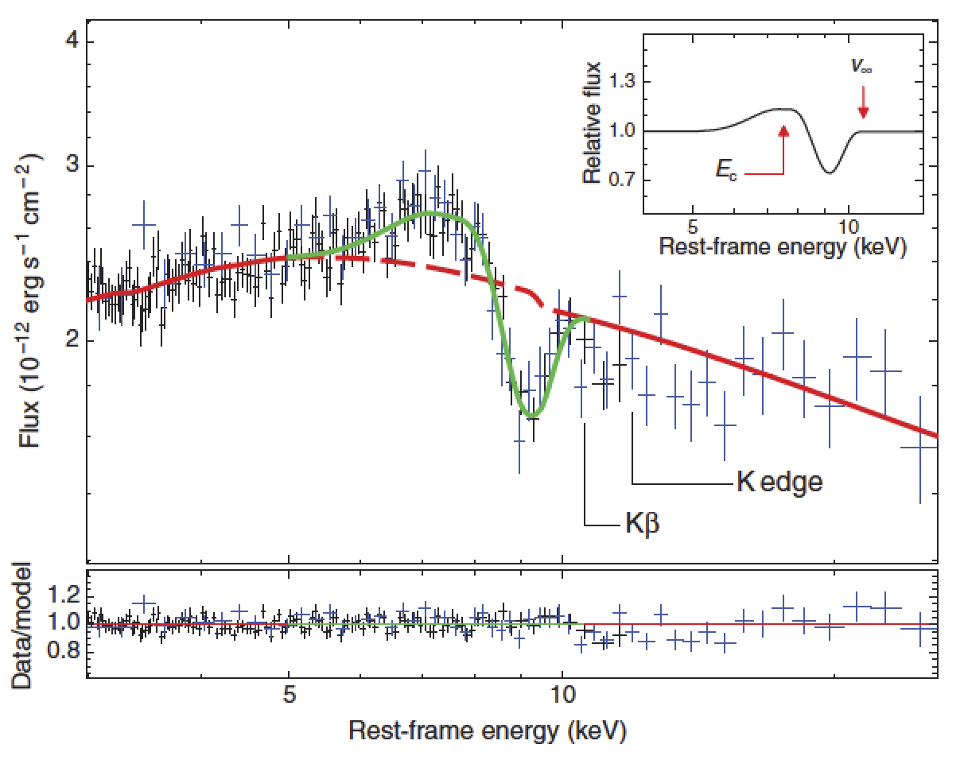
1. The most powerful X-ray Outflows
PDS456
X-ray Fe K absorption lines, E_{k} ~ 10% L_{Edd}
  Large opening angle, ~100 degrees (P Cygni Profile)
  Long life, >~ 1yr
  Mildly relativistic speed, ~0.1 c
  High column density, N_{H} ~10²²–10²⁴ cm⁻²
  Highly ionized with ionization parameter log ε ~ 4-6 erg s⁻¹ cm
  # More powerful than transient narrow-line UFOs (ultra fast outflows)
  # A strong independent indicator for the Eddington ratio R_{Edd}~1 near a BH
Playing a fundamental role
  Quenching star formation (energy-conserving outflow E_{k,} > 0.5% L_{Edd})
  Studying radio jets and un-collimated outflows at the Eddington luminosity
PG 1211+143
P Cygni profile
Tombesi+ 2017
IRAS F1119+3257
References: Pounds+ 2008, Tombesi+ 2015, Nardini+ 2015, Tombesi 2016

Slide 3
2. Sciences behind Radio counterparts
Only 3 sources with the powerful X-ray outflows:
---- PDS 456, IRAS F1119+3257, PG 1211+143
Optically luminous AGN with a positional error of ~0.04 mas (GAIA DR2).
Not radio quiescent at R_{Edd}=L_{bol}/L_{Edd}~ 1
  VLA detection fraction: 100%
  VLA flux > 1 mJy at 1.4 GHz
VLA: Unresolved (size <1 kpc)
Optically thin radio spectra
Radiatively driven outflows
Matzeu+2017
PDS 456
P Cygni profile => Evidence for wide-angle outflows

Slide 4
Radio sources at R_{Edd}≳1
# Massive and supermassive BHs in AGNs
(1) Nearby Low-mass BHs with R_{Edd}~1 and mass <10⁷ M_{sun}
-- Very radio quiet. 5% VLA detection in 19 sources (Greene et al. 2006).
(2) Tidal disruption events (TDEs)
-- Only the TDE in Arp 299B shows a collimated and mildly relativistic jet (Martila et al. 2018).
# Stellar-mass BHs
(1) Ultra luminous X-ray (ULX) sources in nearby galaxies
No VLBI detections of compact radio cores (Yang et al. 2015)
(2) Black hole binaries in the Milky Way
Quenched, (≳ 100x weaker), at the high-soft state (e.g. Fender et al. 2004).

Slide 5
More specific goals for VLBI observations
Is there radio emission at the pc scale resulted from BHs at R_{Edd}~1?
# Searching for radio components near the GAIA position.
# Identifying radio cores via spectral index and proper motion measurements.
(b) Are they powered by these wide-aperture X-ray outflows via internal shocks?
# Requesting deep VLBI images to measure the opening angle of jets/outflows.
Summary of the three radio-quiet sources with the extremely powerful winds
Sourcei | z | L_{bol} (L_{Edd}) | M_{bh} (M_{sun}) | Log(L_{bol}) (erg/s) | S_{VLA21cm} (mJy) | L_{R} (erg/s) | E_{x-wind} (erg/s) | _{References}
IRASF1119+3257 (J1114+3241) | 0.189 | ~5 | 1.6E7 | 46.2 | 110 | 1.5E41 | 2.0E45 | Tombesi+ 2015
PDS 456 (J1728-1415) | 0.184 | ~1 | 1.0E9 | 47.0 | 23 | 3.0E40 | 2.0E46 | Nardini+ 2015 Matzeu+ 2017
PG 1211+143 (J121417+140313) | 0.0809 | ~4 | 1.0E7 | 45.7 | 2.1 | 4.6E38 | 1.3E45 | Lobban+ 2018 Danehkar+2018

Slide 6
3. VLBI imaging results
List of the used VLBI experiments and their basic information
Source | Network | Project Code | Freq. (GHz) | Valid BW (Mbps) | Time (hour) | Date
IRASF1119+3257 (J1114+3241) | EVN EVN | EY024B RSY04 | 1.7 5 | 768 1536 | 4.0 2.3 | 2016 Mar 08 2016 Nov 16
PDS 456 | EVN | EY027* EY024A | 1.7 5 | 768 1536 | 6 2 | 2018 Mar 28 2016 Feb 3
PG 1211+143 | VLBA VLBA | BS128 BA114B | 1.7 5 | 256 2048 | 1.8 0.8 | 2003 Jul 12 2015 Aug 4

Slide 7
1.7 GHz
# 4 hour
# EVN telescopes:
Ef, Jb1, Ro, T6, Sr
Hh, Sv, Zc, Tr, Ur, O8, Mc, Wb
Flux ratio
S_{rec}/S_{app} ~ 350
Constraint on
β cosθ ~ 0.6
Opening angle
~60 deg
Swinging jet?
Core/Gaia DR2
Receding
Jet
VLBA at 2.3 GHz
Gaia DR2
Approaching
jet
Image rms: 0.007 mJy/beam
Image rms: 0.02 mJy/beam

Slide 8
Faint and extended central components C1 and C2, T_{b}~10⁵⁻⁶ K
---- two-sided jet or uncollimated outflows?
Gaia DR2
Yang et al. 2018, MNRAS, submitted

Slide 9
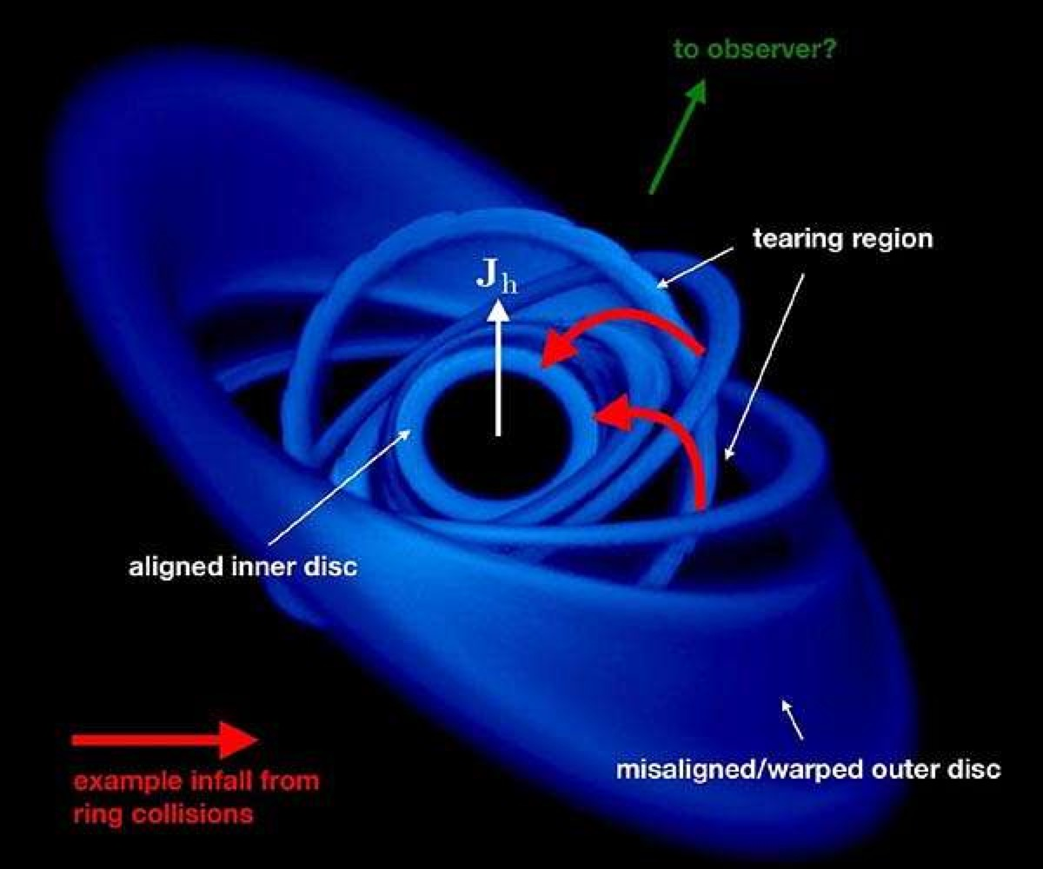
PG 1211+143 with relativistic X-ray outflows and inflows
(1) Detected at 1.6 GHz
# S_{1.7} = 2.9 mJy, S_{peak}=0.6 mJy/beam
# Image rms: 0.12 mJy/beam
(2) No detection at 5 GHz.
# Radio core: S₅<= 0.1 mJy (3σ)
# Image rms: 0.03 mJy/beam
(3) Inflows at 0.3c
# No standard plane of circular accretion disc
(Pounds et al. 2018).
Non-detection
+
VLBA at 1.6 GHz
VLBA at 5 GHz
# A jet powered mainly by BH spin?

Slide 10
VLBI Imaging results
Source | Freq. (GHz) | Scale (pc/mas) | Max. Size (mas) | Sensitivity (mJy/beam) | Svlbi (mJy) | Score (mJy) | Lcore | Structure
IRASF1119+3257 (J1114+3241) | 1.7 5 | 3.1 | 50 | 0.007 | 84 11 | 0.5 <0.06 | 1.6E39 3.0E38 | CSO
PDS 456 | 5 |  | 200 | 0.035 | 2.6 | <=0.3 | <=1.4E39 | CSO
PG 1211+143 | 1.7 5 | 1.5 | 30 | 0.2 0.03 | 2.5 0.1 | <=0.6 <=0.1 | 1.6E38 7.9E37 | CSO?

Slide 11
Summary of the preliminary VLBI results
There exists significant radio emission quite close (<=30 pc) to these SBHs at R_{Edd}~1.
The radio emission mainly comes from AGN activity instead of stellar formation activity due to the linear structure.
No strong Doppler-beaming effect according to the symmetric and extended structures.
Collaborators -- Zsolt Paragi (JIVE), Willem Baan (ASTRON), Tao AN (ShAO), Prashanth Mohan (ShAO)

