Slide 1
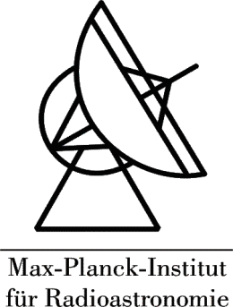

Multi-frequency studies of the jet in the high-redshift quasar S5 0836+710
Laura Vega Garcia
C.M. Fromm, M. Perucho, A.P. Lobanov

Slide 2
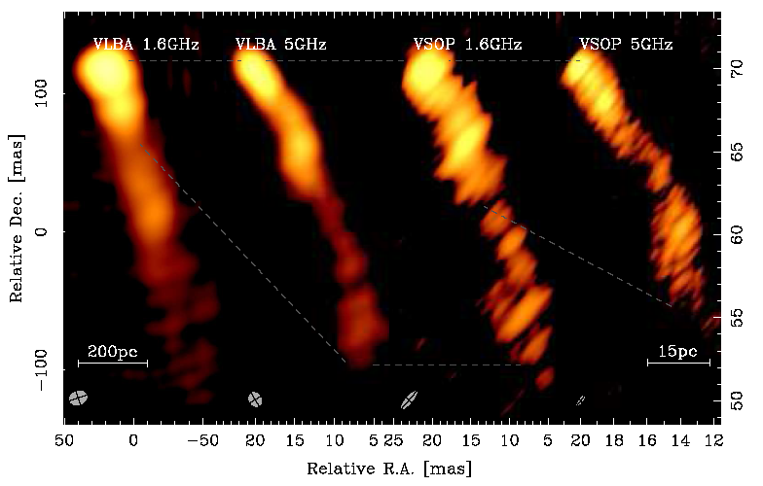
0836+710
Development of instabilities previously suggested
Luminous quasar
z = 2.17
Viewing angle of 3°
Otterbein et al. 1998
e.g. Krichbaum et al 1990, Perucho et al 2012…
Lobanov et al. 2006
Notes:
Left without
Right with

Slide 3
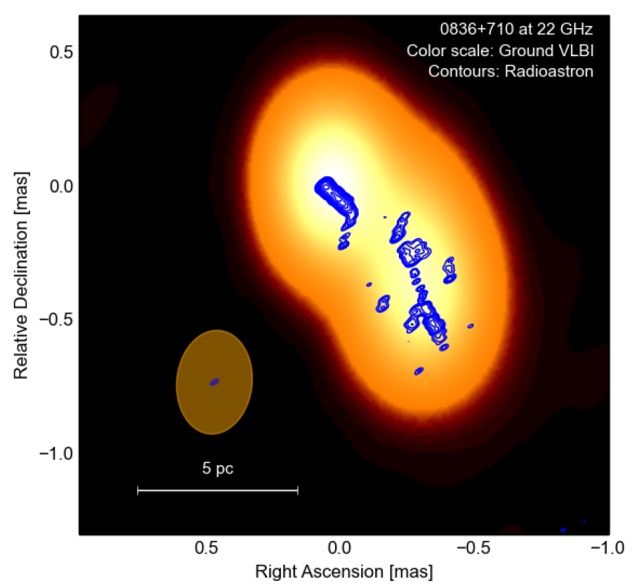
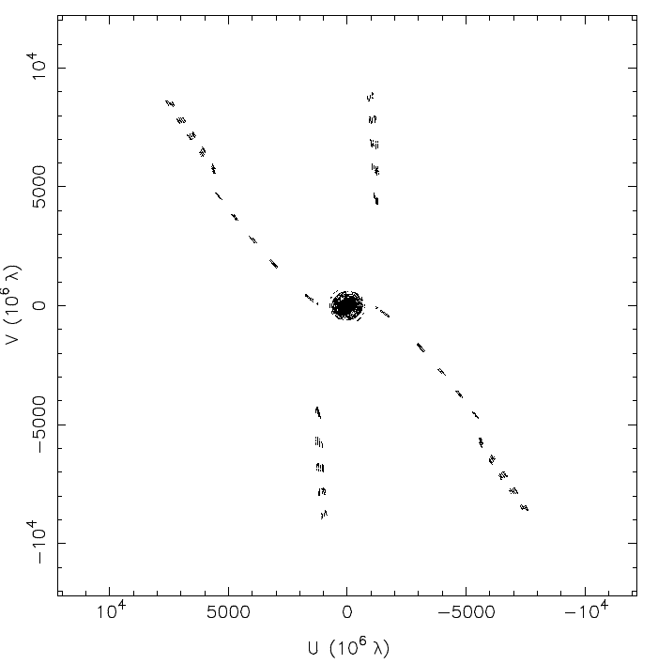
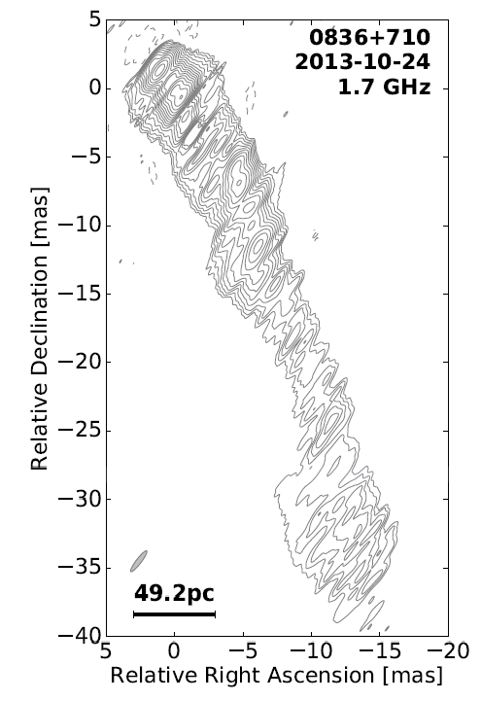
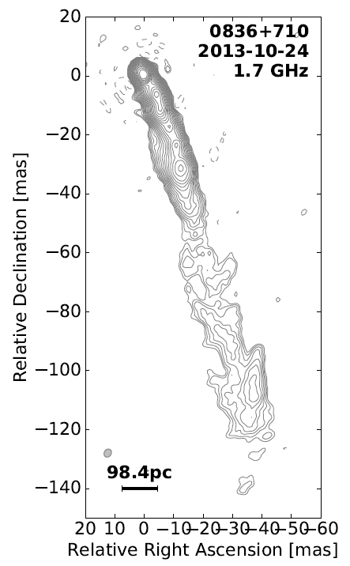
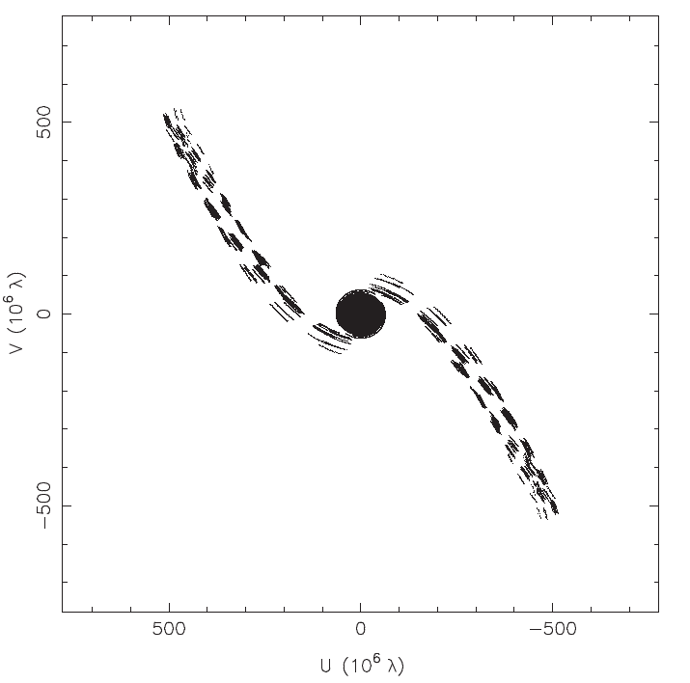
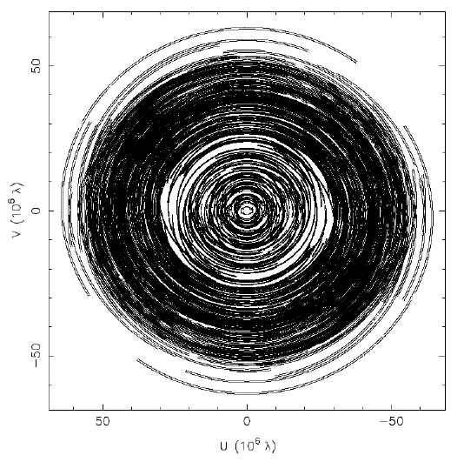


0836+710: RadioAstron maps
Observed with the ground at 1.7,5,15,22, and 43 GHz
Observed with RadioAstron at 1.7,5, and 22 GHz
10 $D_{E}$
Space VLBI
Ground VLBI
Space VLBI
10 $D_{E}$
Multifrequency to determine the spectrum
Simulations to understand the asymmetric 22 GHz image
Notes:
Add earth diameters

Slide 4
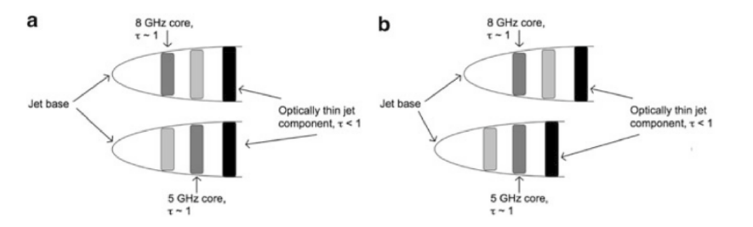
Image Alignment and Coreshift
Correcting for nuclear opacity: aligning images
Aligned
Non aligned
Gabuzda 2015
Software developed for this and further spectral analysis
Notes:
Split into two
Say about the software before

Slide 5
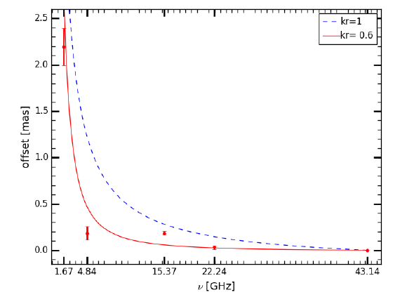
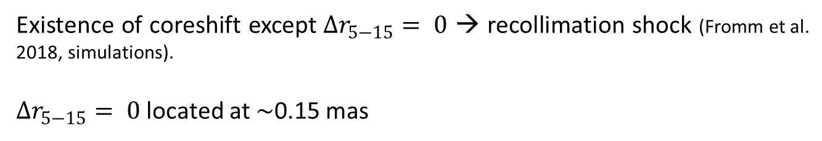
0836+710: Coreshift
Dependence of the coreshift with the frequency
43.1 GHz: reference frequency
Existence of coreshift except $∆r_{5−15}= 0$ → recollimation shock (Fromm et al. 2018, simulations).
$∆r_{5−15}= 0$ located at $\sim$0.15 mas
Notes:
Explain better
Reference

Slide 6
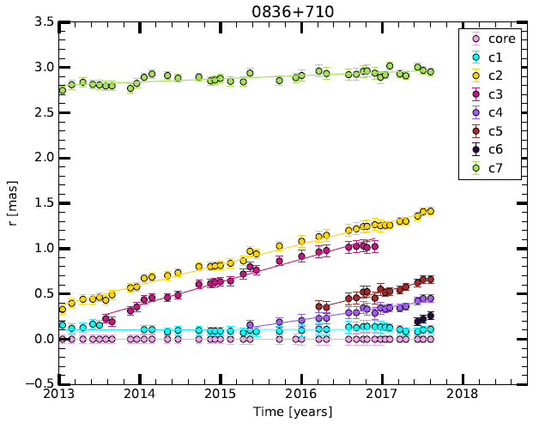



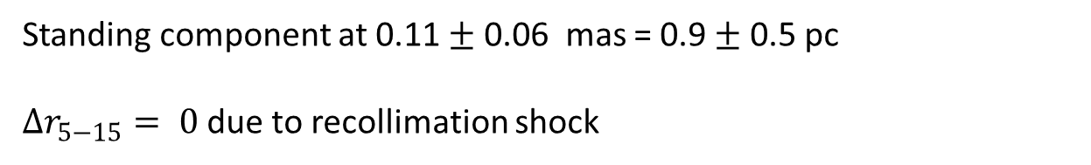


0836+710: Kinematics
Locating the recollimation shock using kinematics
43 GHz
Images from Boston University program
$$β_{app,c2}=19.0 ±0.7$$
$$β_{app,c3}=21.4 ±1.3$$
$$β_{app,c5}=19 ±4$$
$$β_{app,c4}=11 ±2$$
$$β_{app,c1}=0.1 ±0.2$$
Standing component at 0.11 $±$ 0.06 mas = 0.9 $±$ 0.5 pc
$∆r_{5−15}= 0$ due to recollimation shock
Notes:
Bu write boston universitz

Slide 7
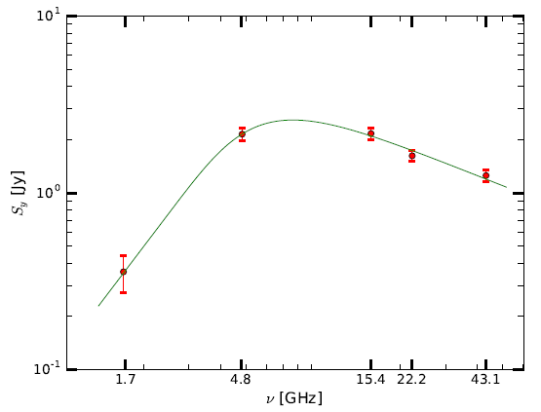


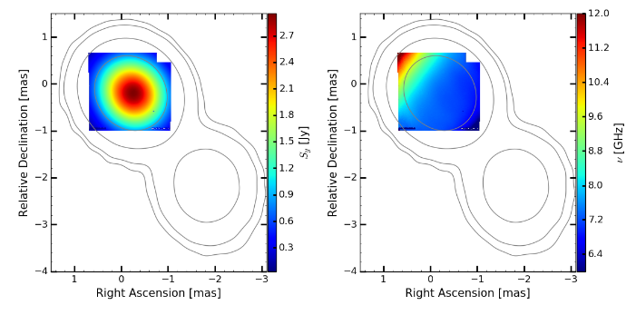

0836+710: Synchrotron spectrum
Fit of each pixel spectrum using the formula of the synchrotron spectrum
Synchrotron spectrum
$$ν_{m},S_{m}$$
with
(look Lobanov+1998, Sokolovsky+ 2011, Fromm+2013)
Turnover flux density
Turnover frequency
Notes:
Write sm num in the peak in the plot
Flip it back

Slide 8
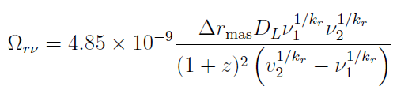



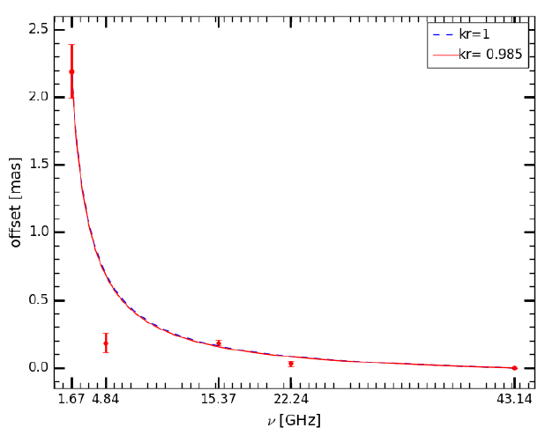




0836+710: Core Magnetic field
Using the synchrotron spectrum: $B∝ν_{m}^{5}S_{m}^{−2}$
$B_{c,5GHz }$ $\sim 0.03$ G
Using the coreshift
Coreshift measurement
Core magnetic field
Only if $k_{r }=1$ and $α=0.5$
(for illustration and simplicity)
$B_{c,5GHz }$ $\sim 0.0043$ G if $k_{r }≠1$
$B_{c,5GHz }$ $\sim 0.04$ G if $k_{r }=1$
Notes:
Equations
Change order

Slide 9
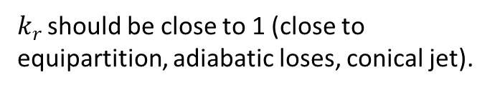


0836+710: Core Magnetic field
Using the synchrotron spectrum: $B∝ν_{m}^{5}S_{m}^{−2}$
$B_{c,5GHz }$ $\sim 0.03$ G
$k_{r }$should be close to 1 (close to equipartition, adiabatic loses, conical jet).
Using the coreshift
Coreshift measurement
Core magnetic field
Only if $k_{r }=1$ and $α=0.5$
(for illustration and simplicity)
$B_{c,5GHz }$ $\sim 0.0043$ G if $k_{r }≠1$
$B_{c,5GHz }$ $\sim 0.04$ G if $k_{r }=1$
Notes:
Equations
Change order

Slide 10

Asymmetries
Can be due either to difference on Doppler factor or to the magnetic field configuration
To test it: SRMHD and emission simulations (Porth and Komissarov 2015, Fromm et al 2018)

Slide 11
Asymmetries
Three parameters to study:
  Magnetic field configuration
  Doppler Boosting
  Opacity

Slide 12
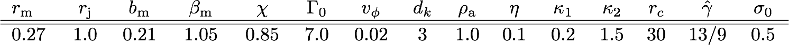
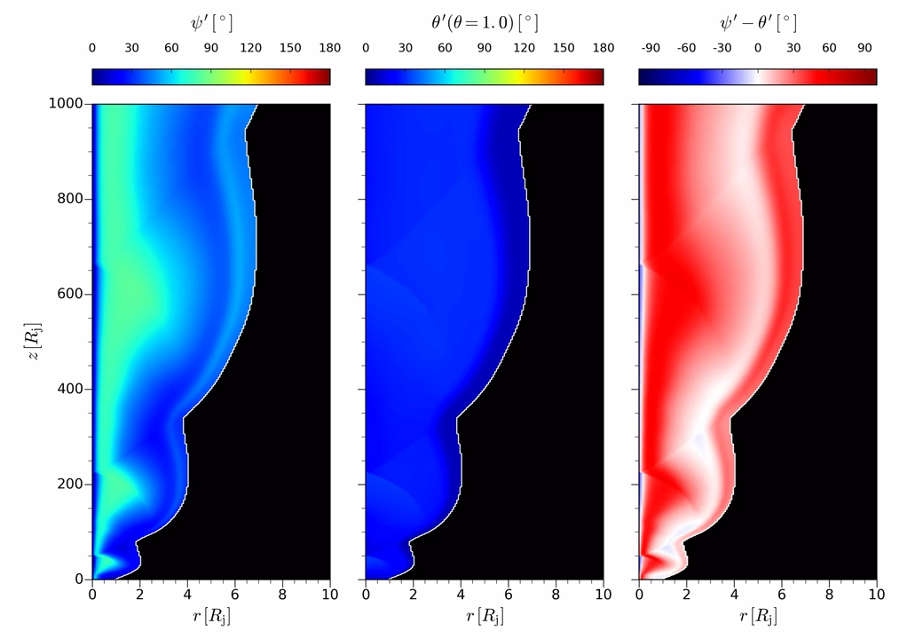

Asymmetries
Ordered magnetic field, maximum asymmetries if

Slide 13
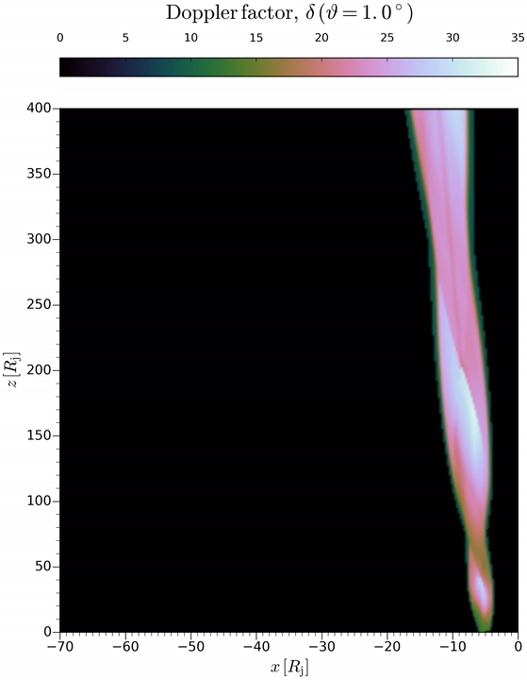
Asymmetries
Doppler Boosting

Slide 14
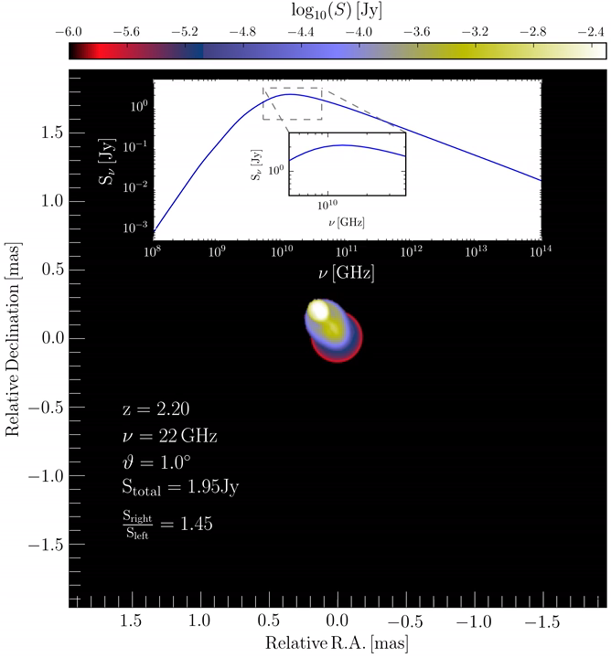
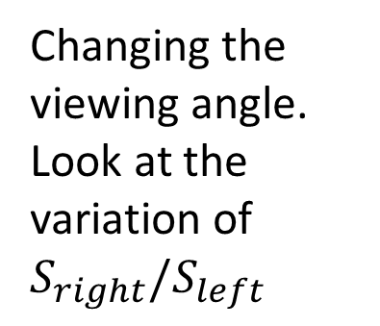
Asymmetries
Changing the viewing angle. Look at the variation of $S_{right}/S_{left}$

Slide 15
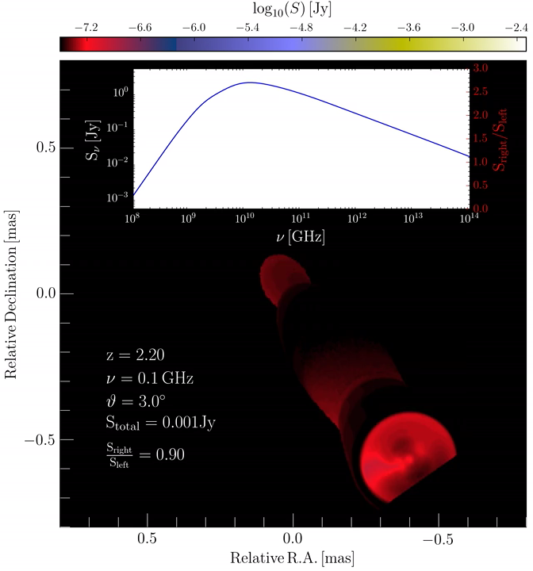
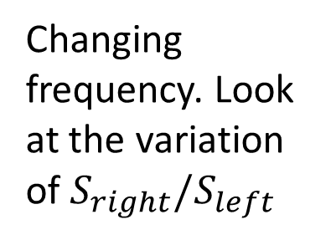
Asymmetries
Changing frequency. Look at the variation of $S_{right}/S_{left}$

Slide 16
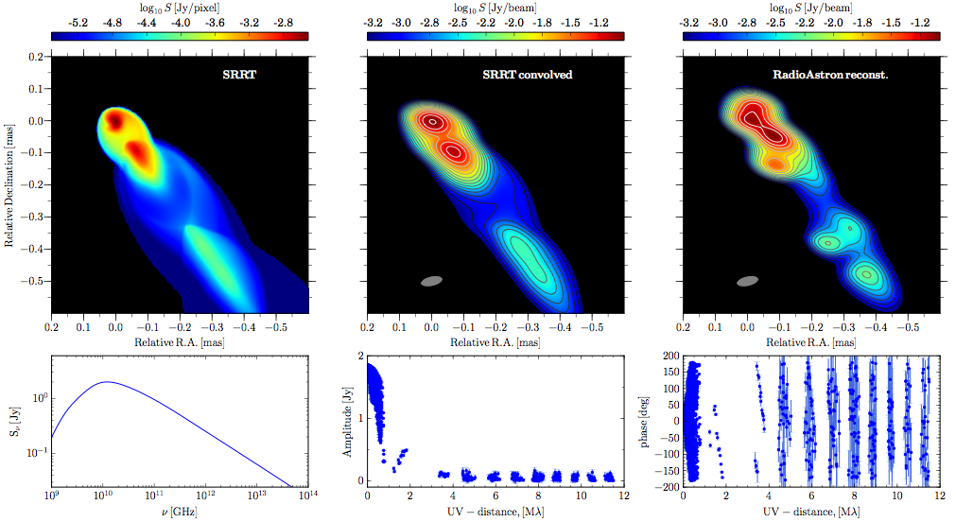
Synthetic imaging
MEM reconstruction

Slide 17
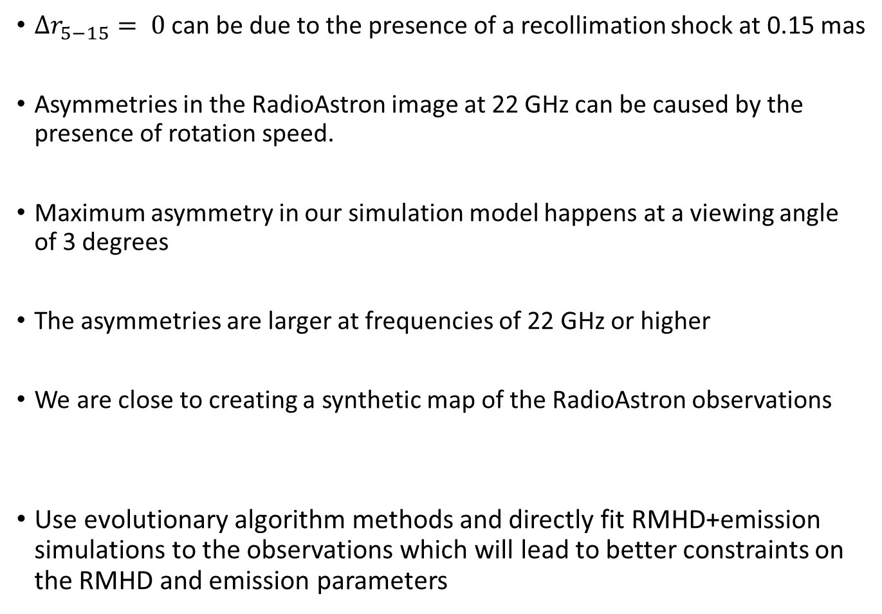
Summary
$∆r_{5−15}= 0$ can be due to the presence of a recollimation shock at 0.15 mas
Asymmetries in the RadioAstron image at 22 GHz can be caused by the presence of rotation speed.
Maximum asymmetry in our simulation model happens at a viewing angle of 3 degrees
The asymmetries are larger at frequencies of 22 GHz or higher
We are close to creating a synthetic map of the RadioAstron observations
Use evolutionary algorithm methods and directly fit RMHD+emission simulations to the observations which will lead to better constraints on the RMHD and emission parameters
Outlook

Slide 19

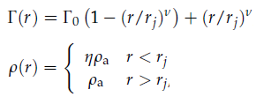

SRMHD setup
(Porth+Komissarov 2015, Fromm et al. 2018)
pressure and magnetic field profile:
with
and
velocity and density profile:
ambient medium profile

Slide 20
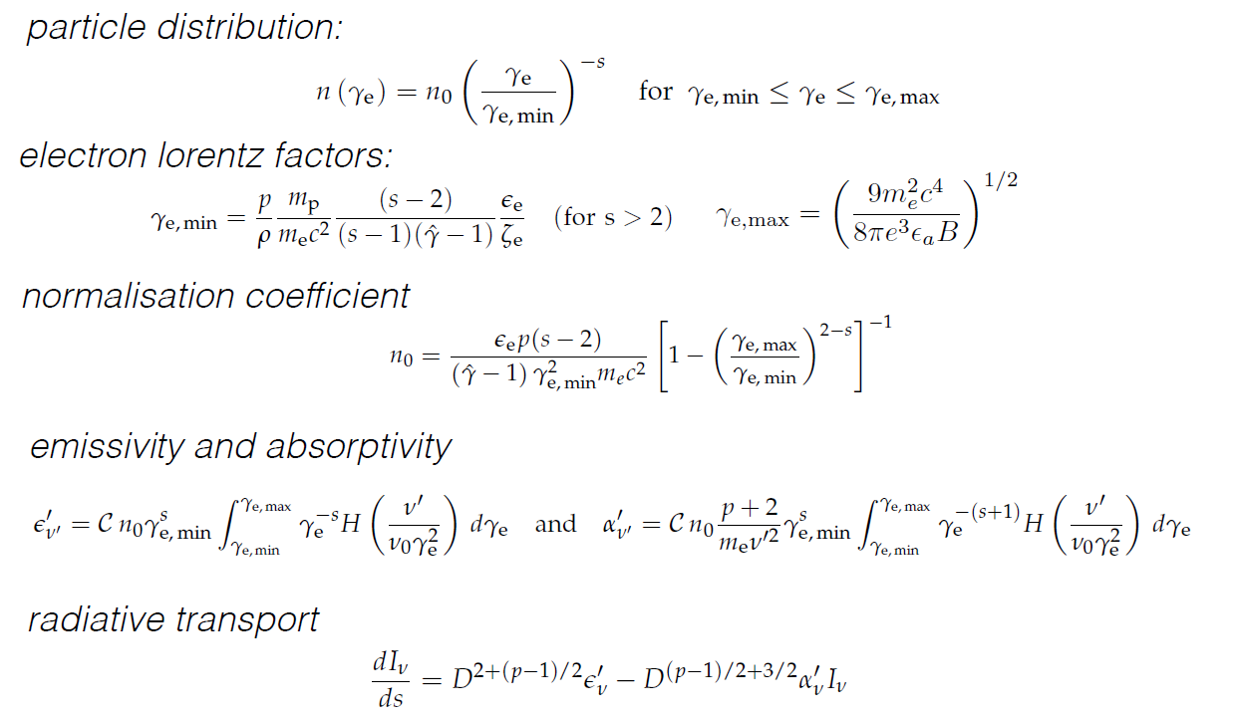
Emission setup
(Mimica 2009, Fromm et al. 2018)

