Slide 1
Continuum Observations of Starbursts VLBI and International LOFAR observations
John Conway (Chalmers Univ/Onsala)
Eskil Varenius (JBCA), Miguel Perez-Torres (IAA/Univ Zaragoza)
Notes:
ppp

Slide 2
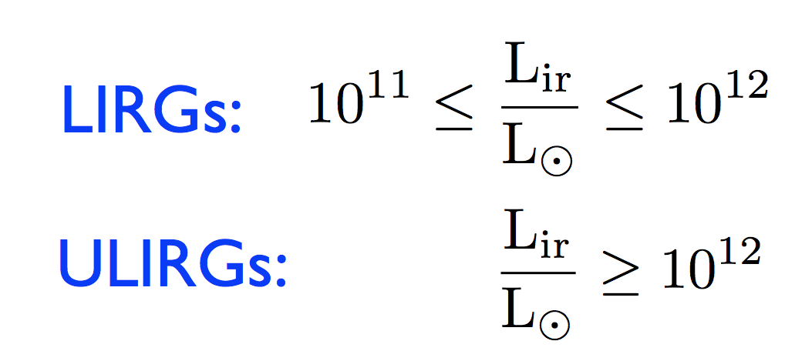
Extreme conditions 10⁵ Msol/pc², 10⁵ cm⁻³ - Test SF models ‘universal’ IMF etc

Slide 3
Goals of Starburst VLBI Observations
Continuum Components - Compact Sources + ‘Diffuse’ SF Disk emission + Outflows
Scientific Questions
- Star-formation in extreme Environments, standard or different? Constrain SF theories
- Origin of the SFR – FIR – Radio correlation – fundamental tool to use radio to trace SF i.e. for SKA, but we don’t understand mechanism. VLBI observes particle acceleration sites.
- Properties and Distribution of Thermal ionized gas– study by free-free absorption observations using international LOFAR.
- Outflows in SF Galaxies – use LOFAR low frequency/high resolution observations as new method to trace galactic mechanical feedback from intense nuclear SF

Slide 4
Talk Contents
Not a complete review. Discusses only highly luminous LIRG/ULIRG sources- focus on recent observations of LIRG Arp299 and ULIRG Arp220 (see N. Ramirez-Olivencia talk for VLBI observations of LIRG/ULIRG sample).
Arp299 VLBI observations
Arp220 VLBI observations
International LOFAR observations of Arp220 and Arp299.

Slide 5
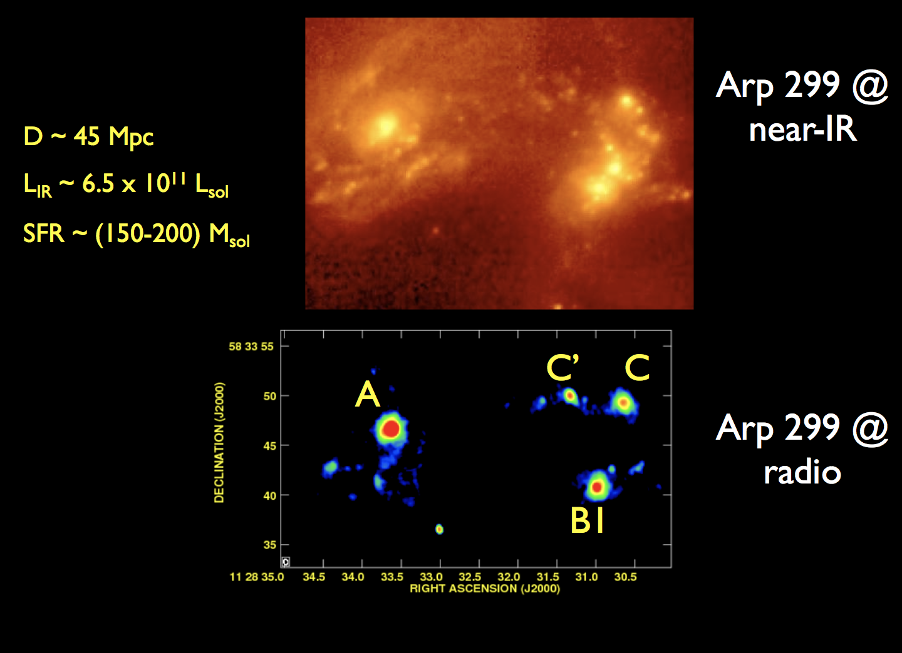
1. Arp 299

Slide 6
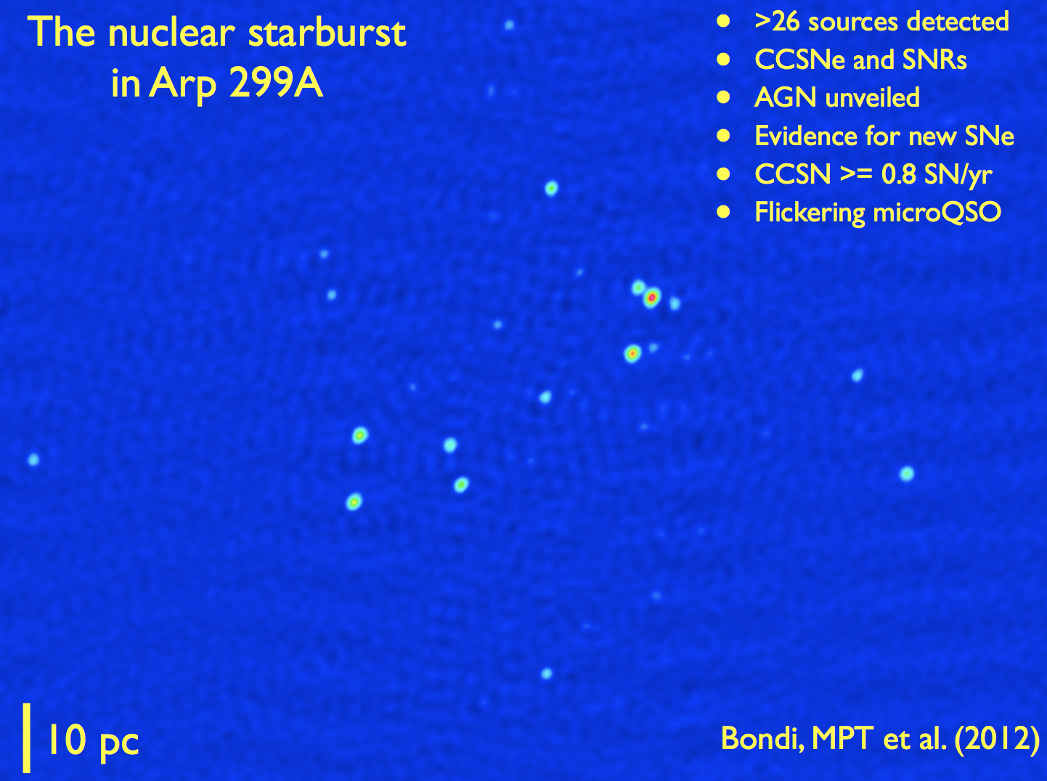
6 EVN epochs stacked at 6cm – rms is 18.5 microJy/beam.
Detection threshold 5 sigma, 26 detected sources.

Slide 7
+ See Talk tomorrow by Miguel Perez-Torres on Tidal Disruption Event (TDE) in Arp299

Slide 8
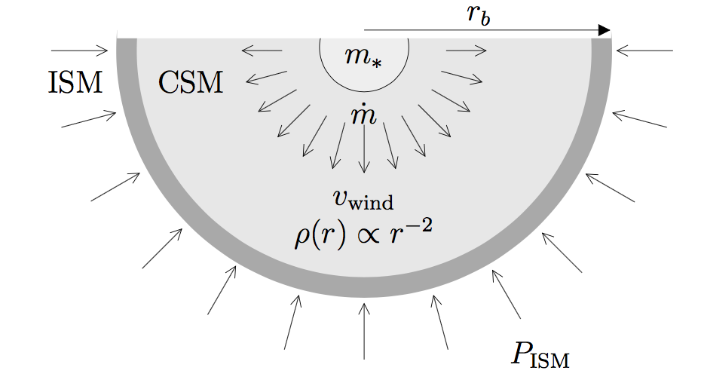
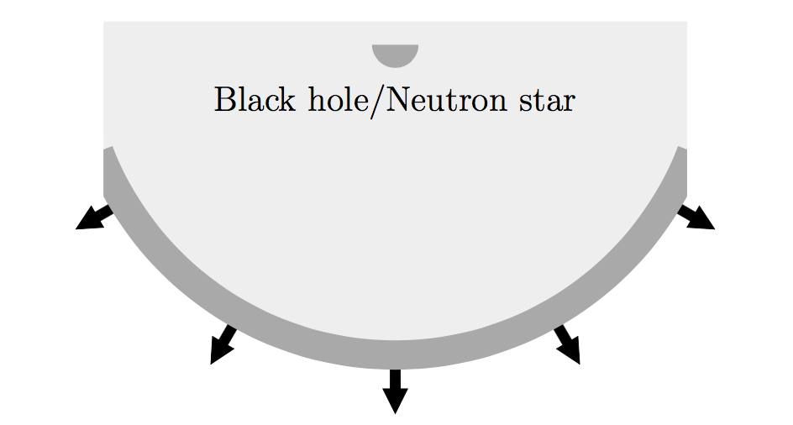
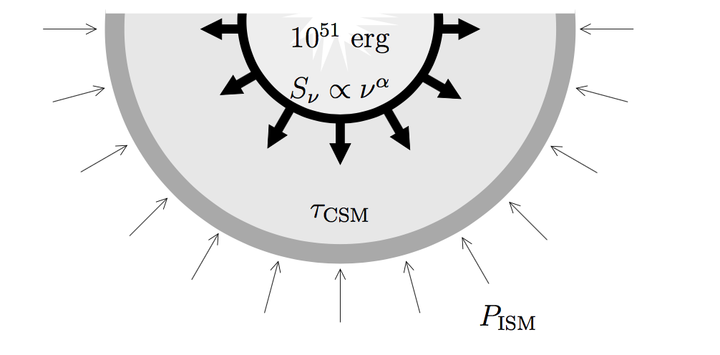
Radio Supernovae (RSNe) and Supernova Remnants (SNR)
Radio Supernova Remnant
Shock wave beyond wind blown bubble and interacts with ISM
NOTE Studying this phase tells us about ISM.
Pre-Supernova Stage.
Massive star inside wind blown bubble with density
Proportional to r⁻².
Radio Supernova Stage
Radio emitting shock transits the wind blown bubble.
NOTE RSNe isolated from ISM so can tell us about stellar evolution.

Slide 9
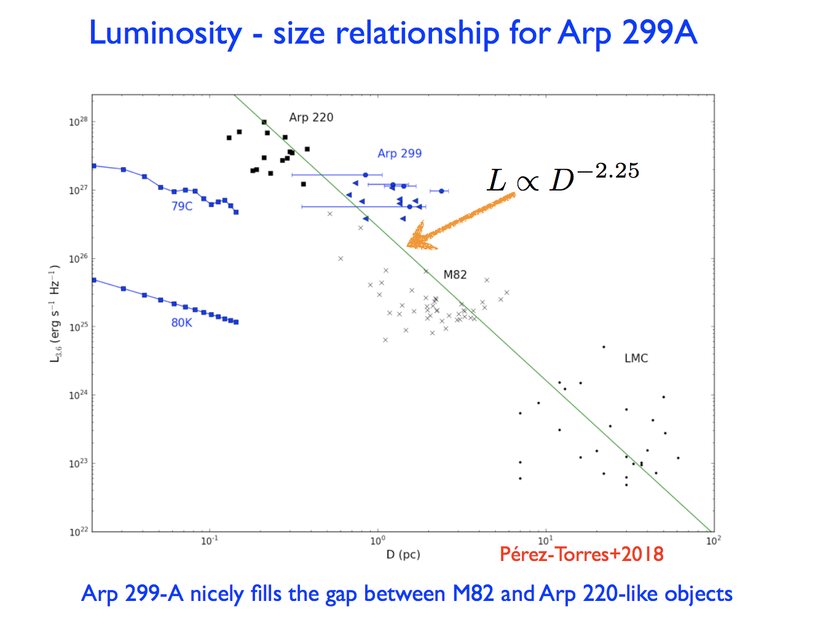
Remaining compact sources mixture of Radio Supernovae (RSNe) and Supernova Remnants (SNRs).
Lightcurves of a few sources definitely RSNe. Also shown by detection of sizes in at least 6 sources (Perez-Torres at al 2018 in prep) consistent with SNR Size-Luminosity relation defined by M82 SNR sizes and Arp220 sizes
(Batejet et al 2011).

Slide 10
Bondi et al 2012 – Based on 2 new sources in 2.5 years estimate RSNe rate 0.82 yr⁻⁻¹ (one sigma confidence 0.30 – 1.88 yr⁻⁻¹ ) and expect based on SFR and standard IMF 0.72 yr^{—1} – No clear evidence in Arp299A one way or other for top heavy IMF.

Slide 11
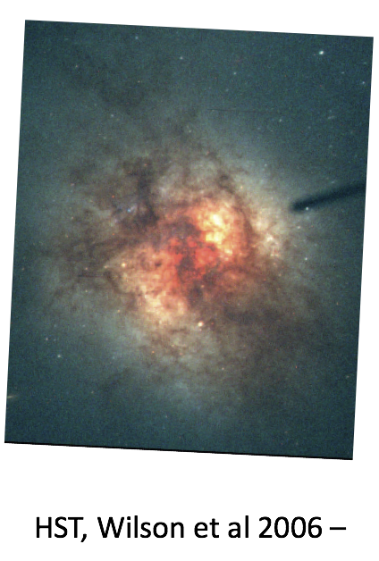
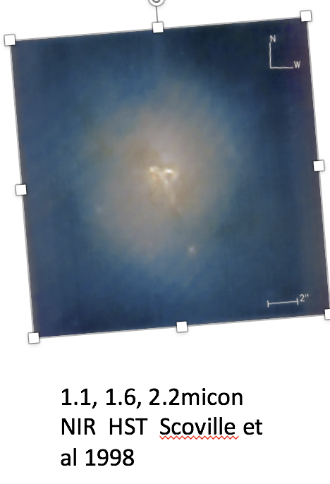
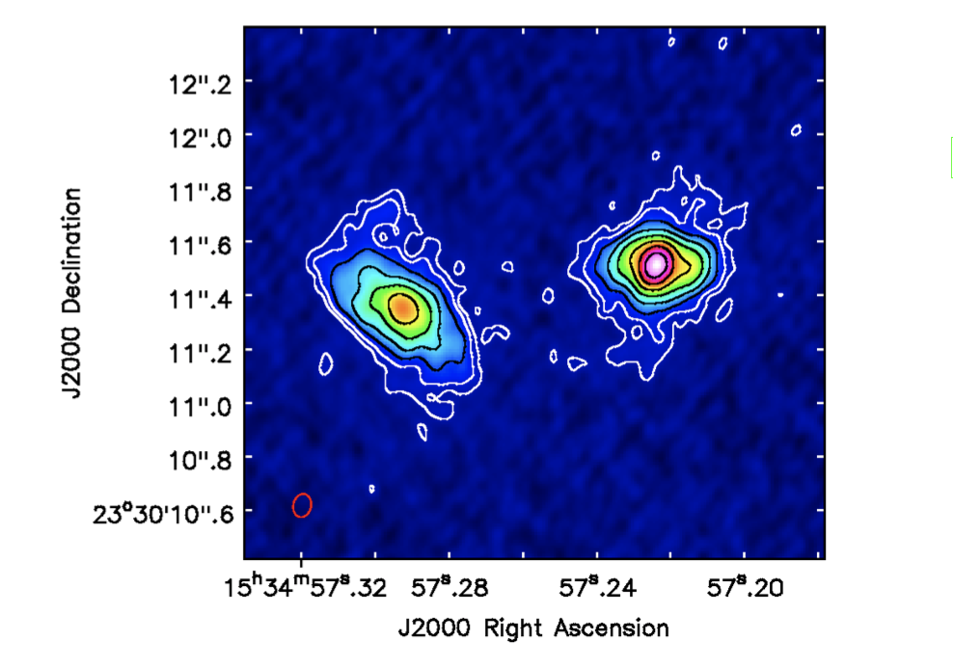
2. Arp220 – ULIRG at D=77 Mpc

Slide 12
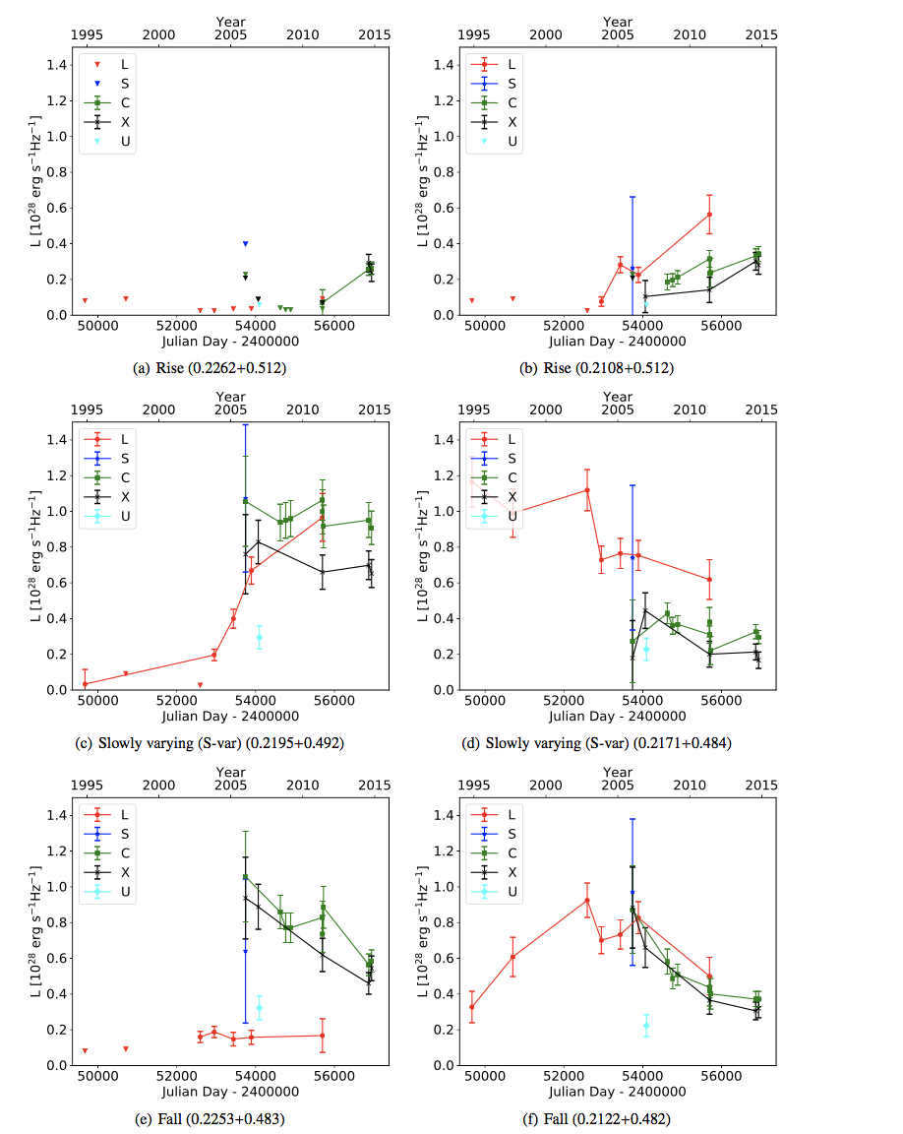
Arp220 VLBI – 23 epochs consistently reduced – Varenius et al 2018 - submitted
Is meant to be a ‘Data Paper’ – with interpretation papers to follow later.
Covers long time series of 20 years at 18cm. 8yrs at 6cm. Plus observations at 2cm, 3.6cm. 13cm. Mixture Global VLBI and HSA observations.
Total of 97 sources detected. A wealth of data.

Slide 13
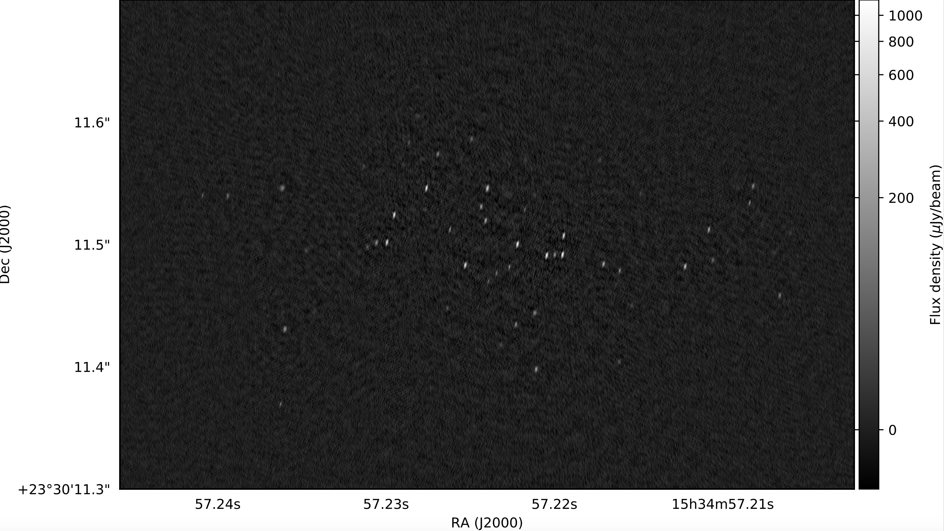
Stacked 6cm image with 4.3 microJy/beam - brightest source with signal to noise >250 (note about 4 times deeper than Stacked Arp299A – compensates larger distance).

Slide 14
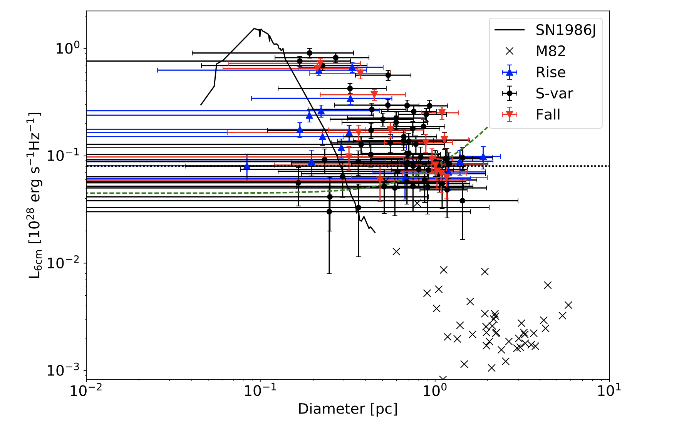
Luminosity versus Diameter plot for Arp220 sources – compared to SN1986J and M82 SNR.
Colours represent lightcurves at 6cm.
In next paper do physical classification into SNe, SNR and Transition objects

Slide 15
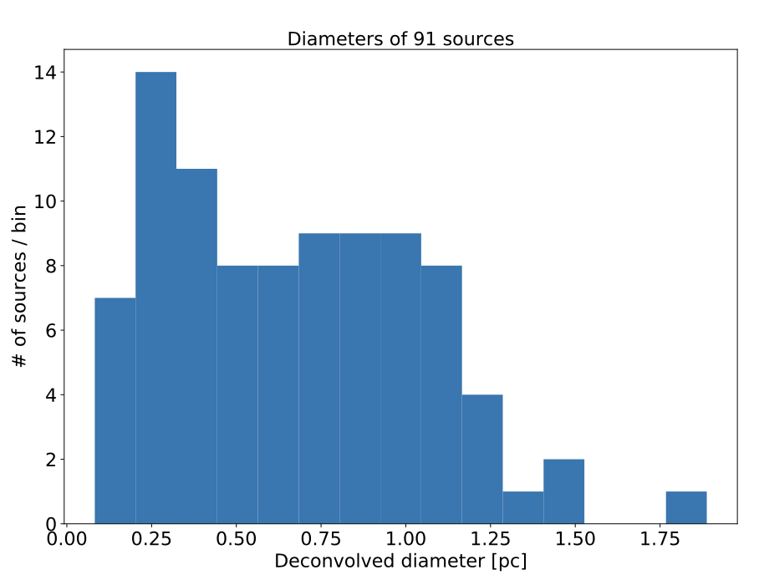
Possible bimodal size distribution consistent with Radio SNe d< 0.4pc expected Wind Blown Bubble diameter
Expected diameter of wind blown bubble (Parra et al 2017) - 0.4 pc

Slide 16
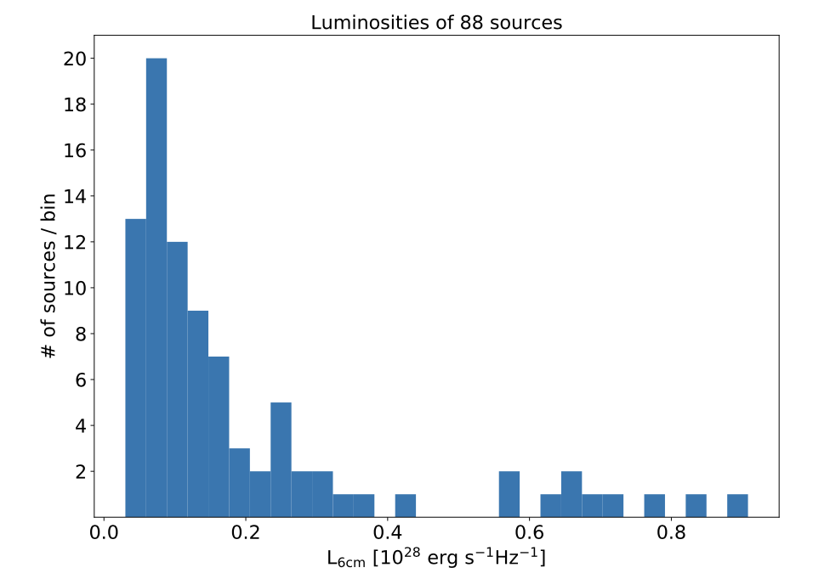
9 sources in range 5 – 10 x10²⁷ erg s⁻¹Hz⁻¹ .
This population of very luminous compact sources are likely very powerful type IIn RSNe
Note Brightest sources in Arp299 is
2x10²⁷ erg⁻¹Hz⁻¹. Quite different despite being within factor of 2 in SFR.
Expected diameter of wind blown bubble (Parra et al 2017) - 0.4 pc

Slide 17
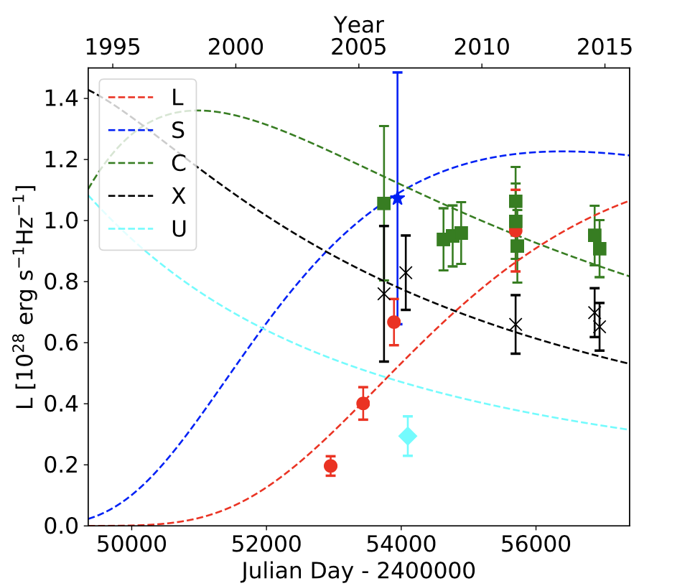
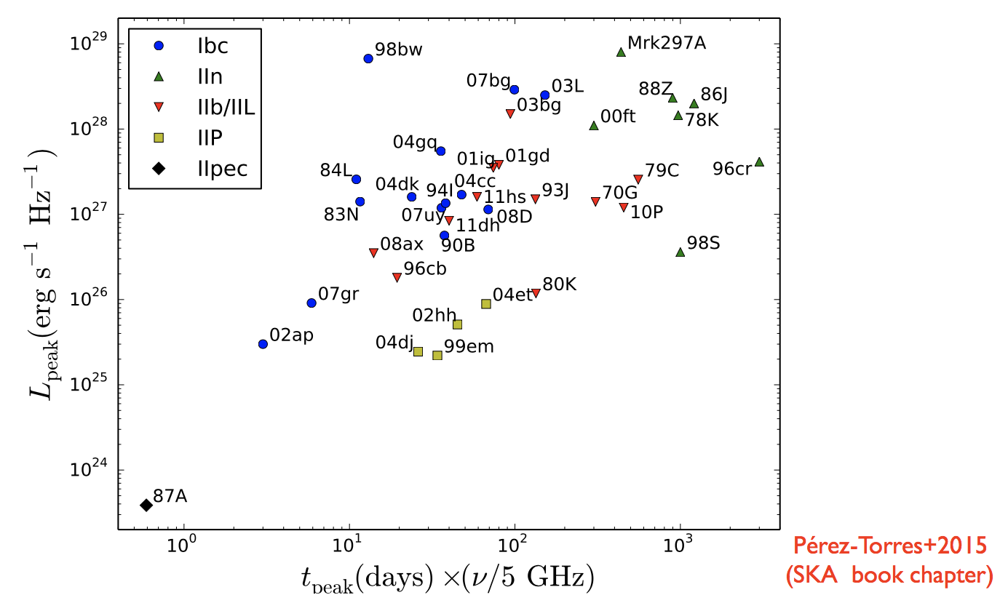
Arp220 Radio Supernovae Modelling
Luminosity Detection limit similar to Arp299 – is 1.7 times more distant but 4 times deeper.
Standard RSNe fit to 0.2195+0.492. - Most Luminous Arp220 source, although a very large 6cm rise time of 16 years (total SNe age 33 yrs).
Brightest sources in Arp220 consistent with rough RSNe luminosity- rise time correlation – but has a 5 GHz rise time larger than any other RSNe –
suggests extreme wind density.

Slide 18
Arp220 has 9 likely RSNe in range 5 -10 x 10²⁷ erg s⁻¹ Hz⁻¹ – Brightest Arp299 is 2x10²⁷ erg s⁻¹ Hz⁻¹ despite having similar SFR to factor of 2 – why so different? Higher gas density?
The Brightest RSNe in Arp220 has record 6cm rise time (16 yrs). Sizes much larger than SN1986J point to others also having long rise time (check in next paper).
Is there a class of progenitors in Arp220 with ultra-dense winds –> top heavy IMF?
Are there more such powerful SNe than expected for standard IMF and consistent with ‘top-heavy’ or standard IMF?
If typical age of the 9 sources > 5 -10 x 10²⁷ erg s⁻¹ Hz⁻¹ is 50 years – occurrence rate 0.4 yr⁻¹. Consistent with expected total IIn rate under standard IMF – BUT all luminous RSNe are type IIn but not all type Iin are luminous RSNe. Only (small) fraction of IIn reach > 5 x 10²⁷ erg s⁻¹ Hz⁻¹ - so observed rate of these sources too high for standard IMF?

Slide 19
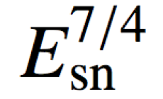
Total observed number of SNR with d = 0.5 – 1.0 pc is 43.
If 4 SNe/yr and age 190yrs expect 760 (!) which is 20 times larger than observed.
Explanations – SNR diameter scales as
(Berezhko and Volk 2004) - maybe only seeing high luminosity tip – but E_{SN} should have narrow dispersion. Observational biases can explain lack?
Alternatively most SNe could explode in densites >1x10⁵ cm⁻³ and become radiative before they accrete mass equal to ejecta mass and so are radio weak.
Expected diameter of wind blown bubble (Parra et al 2017) - 0.4 pc
Age of 1pc Diameter SNR for mean expansion speed 5000 - 1000 km/s is 95 yrs - 190 yrs

Slide 20
Empirical Approach. - Fit Cumulative N(>S) distribution. Power law exponent similar to that for SNR in normal galaxies.
Estimate maximum radiative lifetime 1000 yrs based on B-field and IC losses off radiation. Extrapolate cumulative LF function till there is 4000 sources. Find total cumulative radio flux density is maximum only 25% of to the total flux density in diffuse MERLIN scale disk emission.
Follows diffuse emission not a superposition of weak point sources, and primary electrons don’t have long enough lifetime to diffuse into ISM. What is the diffuse emission?
Lacki et al 2010 predict that electron ‘calorimeter’ models break down in ULIRGs – energy in primary electrons lost to IC in <1000yr lifetimes. We also see SNRs may be less efficient in accelerating primary electrons (too few SNRs)
Lacki et al 2010. Diffuse emission comes from relativistic protons interacting with ISM producing electrons and positrons - Needs ‘Cosmic conspiracy’ for ULIRGS to follow same FIR-Radio correlation as normal galaxies.

Slide 21
3. International LOFAR observations of Arp220/Arp299
Irish station now in place

Slide 22
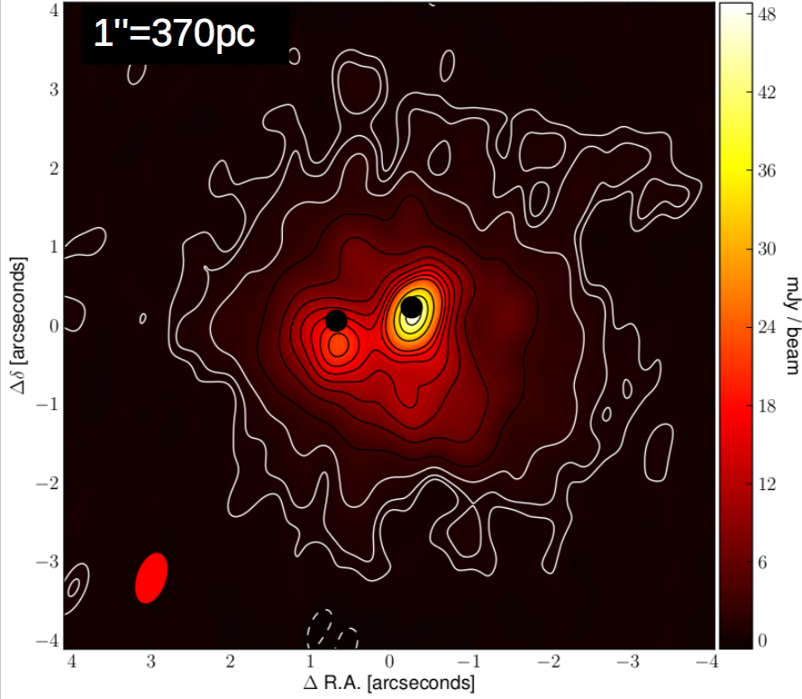
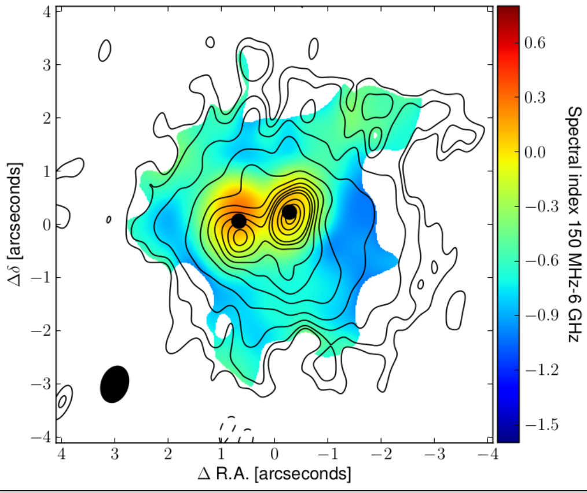
LOFAR Arp220 Varenius et al 2016
International LOFAR 150 MHz 0.4’’ Resolution image. East and West peaks of LOFAR shifted from cm peaks (black dots)
Spectral Index LOFAR 150MHz and matched resolution VLA 6GHz.

Slide 23
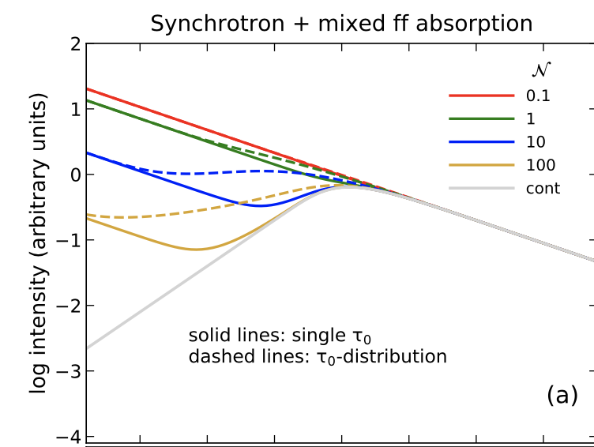
Arp220 Geometry of free-free thermal gas
Model spectra fitting East and West Nucleus – To LOFAR + MERLIN + VLA data. Has for nuclei conventional smooth mixed Synchrotron Condon model – dashed line + power law halo – W Nucleus not well fitted. Vertical line LBA frequency 60MHz-
From Conway, Elitzur and Parra (2018) ‘Radiation Propagation in Clumpy media’ Colours show clumpy ff model. Apply this in Arp220 W Nucleus to get better fit.

Slide 24
Clumpy Free-Free gas
Varenius et al 2016 require to get a fit to the free-free absorption in Arp220 that the thermal emission/synchrotron ratio at 1 GHz is only 0.4% whereas in normal galaxies it is 10%.
Also noted by Barcos-Muñoz et al 2015 that 33GHz VLA was synchrotron dominated not free-free dominated implying low thermal fraction. Suggested ionising photons absorbed by dust.
Important because the 20GHz – 40 GHz region observing free-free emission often discussed as a galaxy SFR indicator.
The small thermal fraction could instead be naturally explained if free-free is in HII regions (i.e Lacki 2013) that are small and optically thick in ULIRG environments

Slide 25
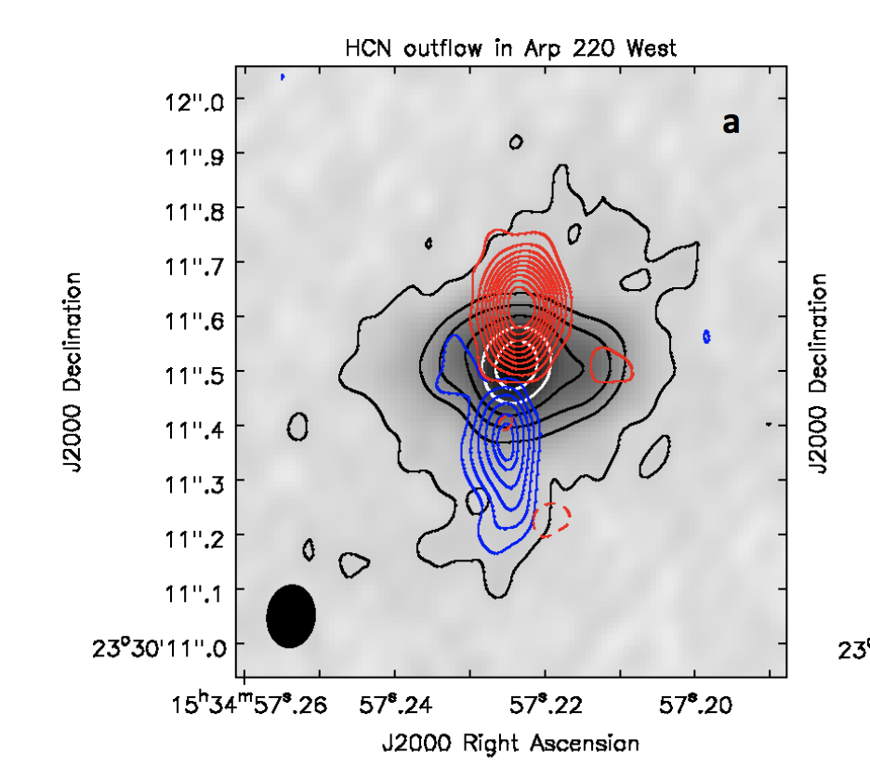
Arp220 Outflows
Recent ALMA HCN detection of outflow in West Nucleus (Barcos-Munoz et al 2017) consistent with LOFAR.
East nucleus?
LOFAR 150 MHz observations suggests outflows in both East and West Nuclei.

Slide 26
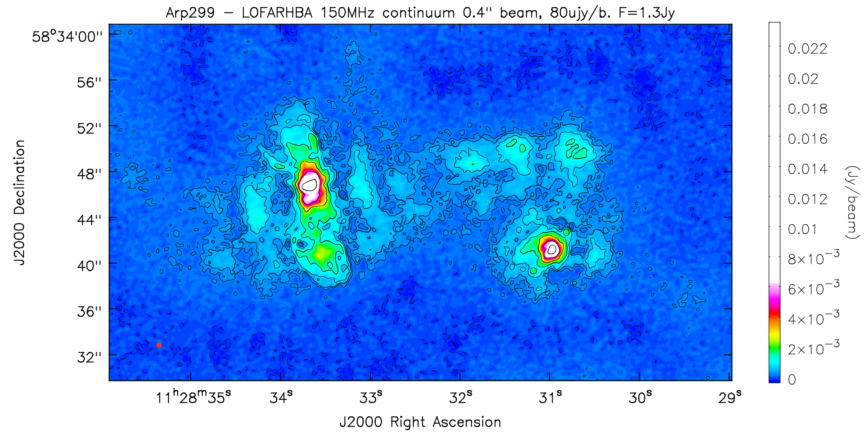
Arp299A LOFAR outflow
Ramírez-Olivencia et al 2018 International LOFAR imaging of Arp299 at 150MHz and 0.4’’ resolution – showing bi-directional outflow. Observing ULIRG sample – apply to LOFAR survey data as new way to detect galactic outflows.

Slide 27
Conclusions
Radio Supernovae in Arp299A broadly consistent with standard IMF, but the very luminous, long rise time RSNe in Arp220 may point to a top heavy IMF.
In Arp220 there appear to be many fewer Radio SNR in size range 0.5 – 1pc than one would expect, also given electron lifetimes < 1000yrs -→ Total radio flux density in Arp220 cannot be ‘sum of compact sources’ and electrons no time to diffuse into ISM. Argue diffuse radio emission is from secondary electrons/positrons – but then needs ‘cosmic conspiracy’ to fit same FIR-radio correlation as normal galaxies !?
LOFAR free-free absorption provides new way to probe geometry of thermal ionised gas in SF galaxies. A clumpy/HII model may fit data better with implications for using high frequency free-free emission as a SF tracer in LIRGs/ULIRGs
LOFAR detections of SF induced galactic outflows provide a new way of detecting SF feedback in galaxies – calibrate mechanical luminosity in a few sources (joint ALMA+LOFAR) and use LOFAR surveys at international resolution to get overall contribution.

