Slide 1


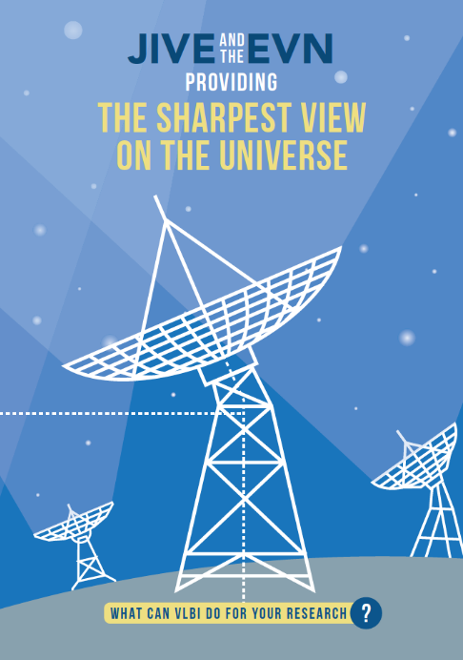


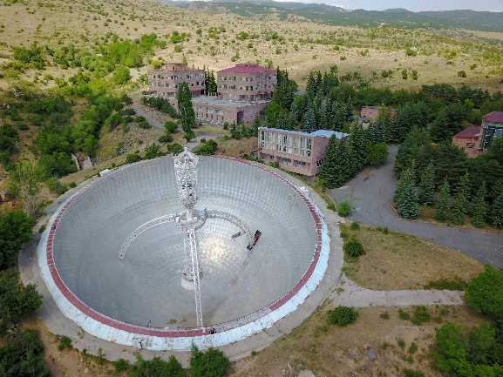

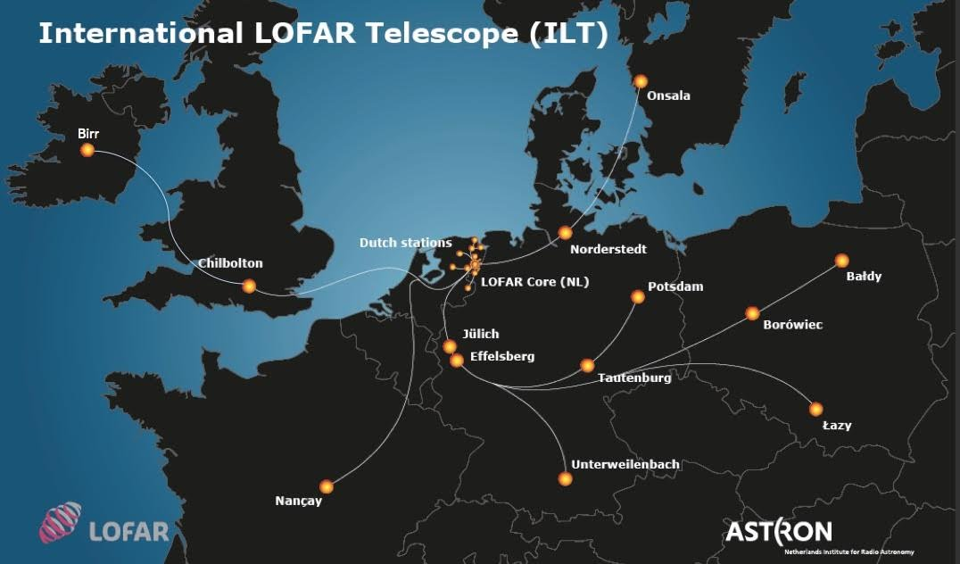
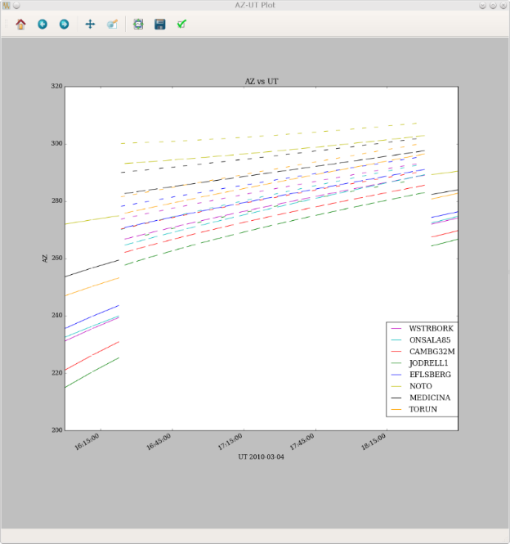
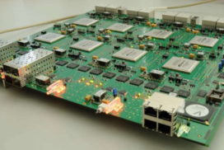
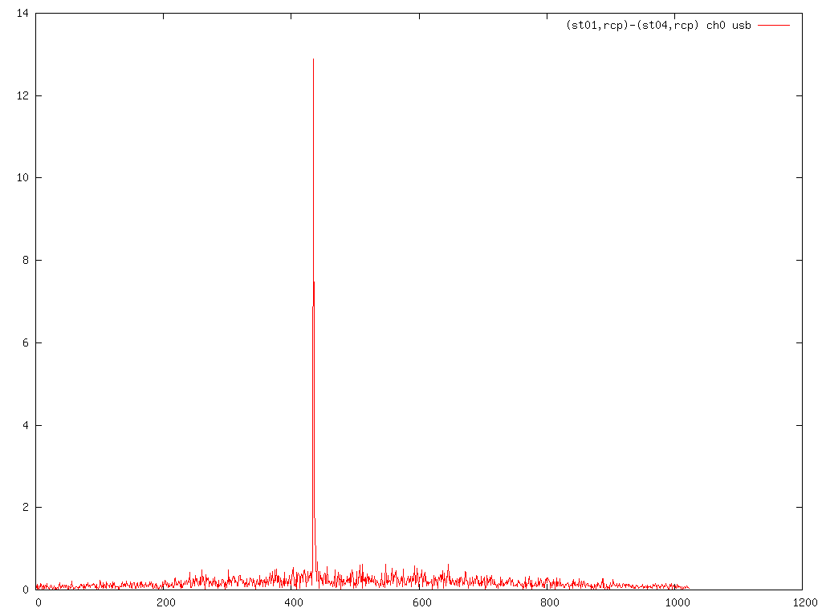
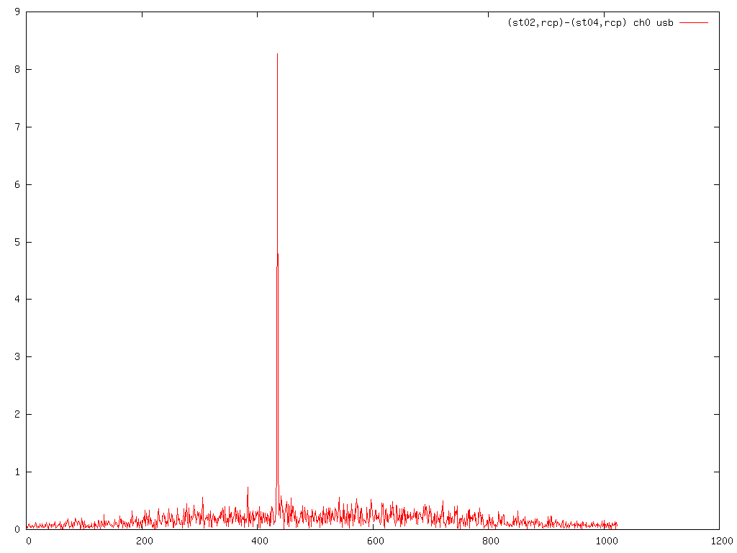
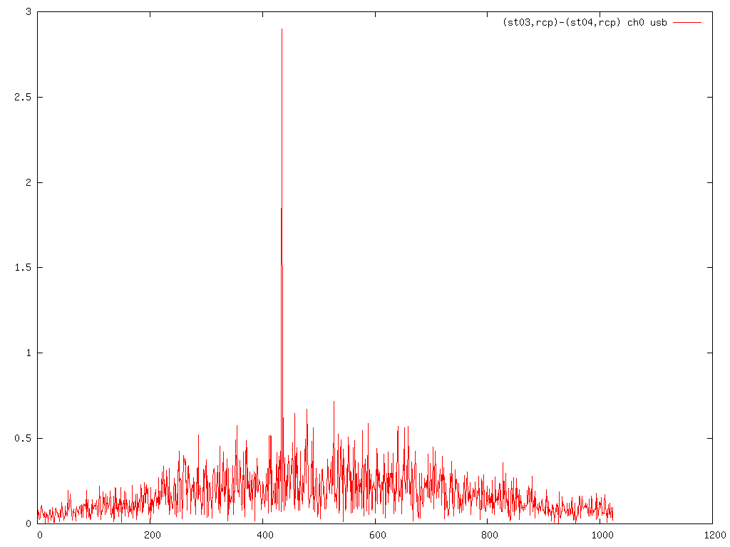
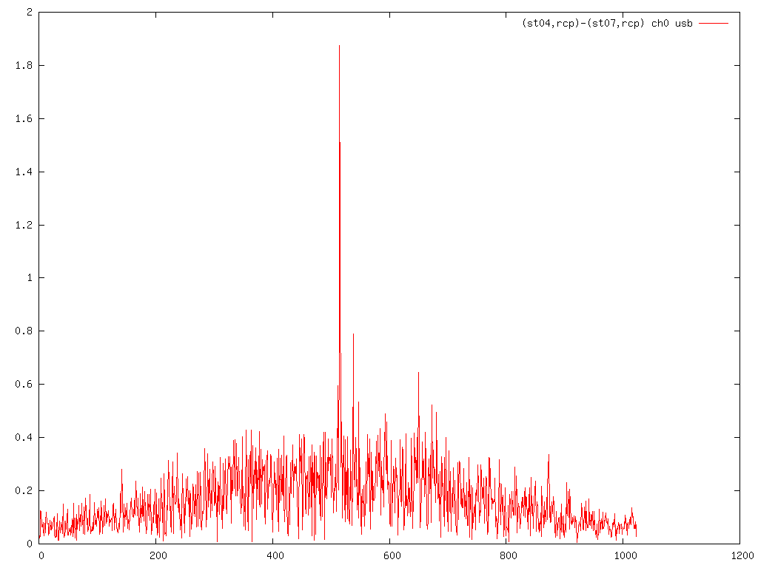
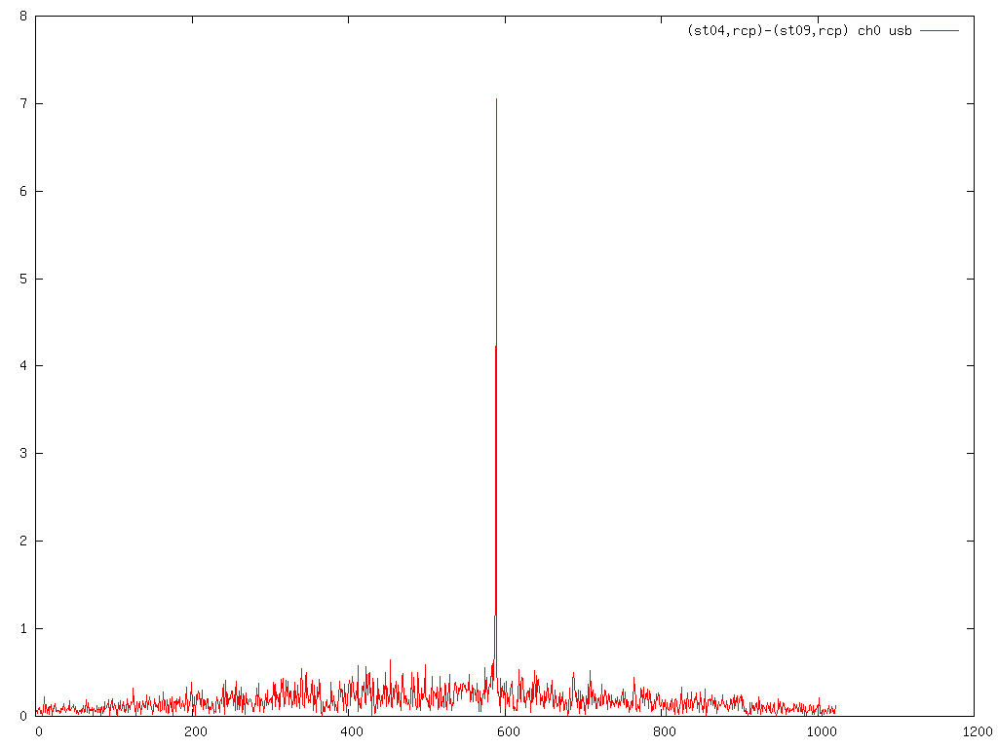
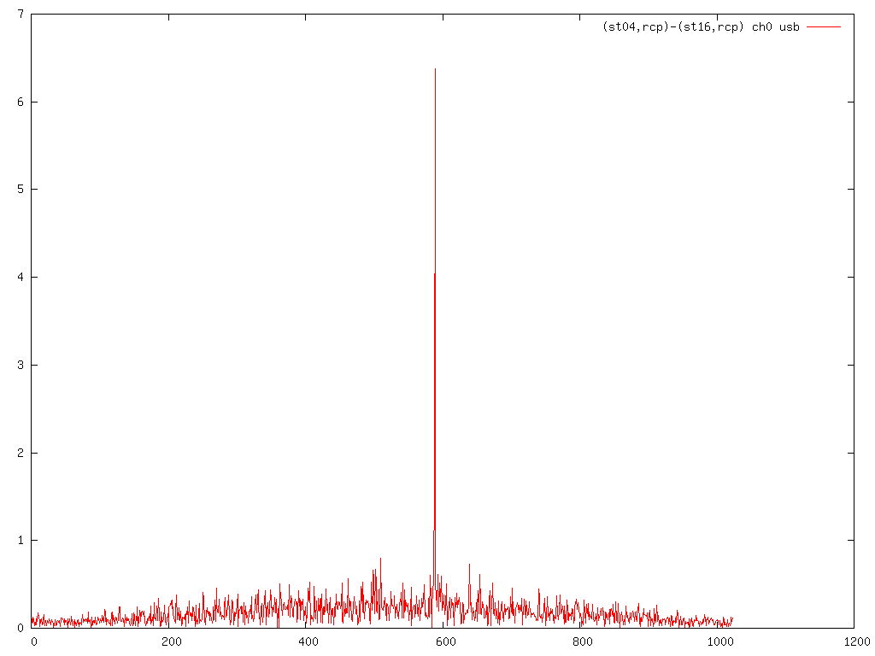
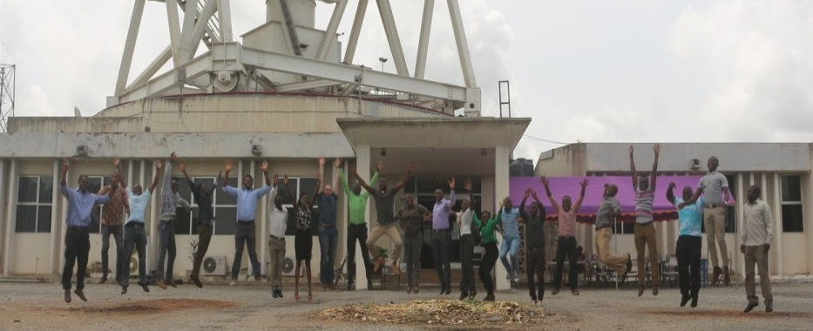
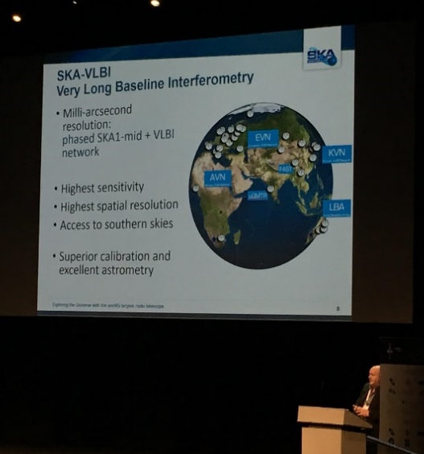
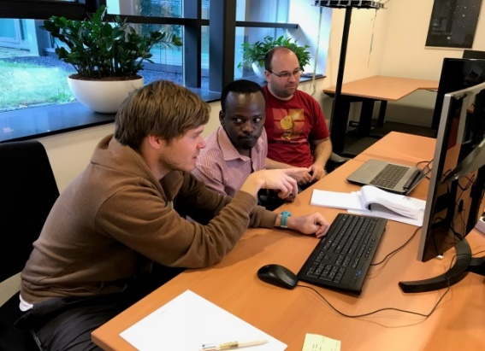
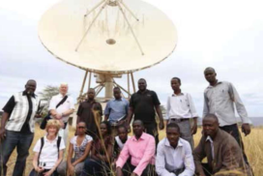


JUMPING JIVE
Joining up Users for Maximizing the Profile, the Innovation and Necessary Globalization of JIVE
JUMPING JIVE aims to take VLBI into the next decade, with JIVE and the EVN as globally recognized centres of excellence in radio astronomy.
Towards a Sustainable JIVE
Outreach and Advocacy: Profiling the scientific impact of VLBI amongst astronomers, the general public, policy maker.
Building new Partnerships: Attract more partners and new countries, involved or interested in VLBI.
ERIC Scope: Exploring synergies between JIVE and the International LOFAR Telescope.
New Science Capabilities
Integrating New Elements: Test and verify the performance of new telescopes in the EVN.
Geodetic Capabilities: Enabling geodetic use of the JIVE data processor.
Cm-EF
Da-EF
Global VLBI Interfaces: Update tools and methods for the EVN telescopes.
De-EF
JB2-EF
Kn-EF
Ta-EF
The Future of VLBI
Capacity for VLBI in Africa: Increasing the links between European based VLBI expertise in Africa.
VLBI with the SKA: Pursue the globalisation of VLBI in the advent of SKA.
The VLBI Future: User community and global partners will define the most important science areas for future VLBI arrays.
Jumping JIVE is an ambitious series of initiatives
Overarching aim to maximise the potential for VLBI via: Advocating , Expanding, and Innovating
jumping.jive.eu
14th EVN symposium – Granada Giuseppe Cimò (JIVE / ASTRON) on behalf of the JUMPING JIVE collaboration
This project has received funding from the European Union’s Horizon 2020 research and innovation programme under grant agreement No 730884

