Slide 1
T.M. Bocanegra Bahamon, L.I. Gurvits, G. Cimo, G. Molera Calves, D.A. Duev and S. Pogrebenko

Slide 2
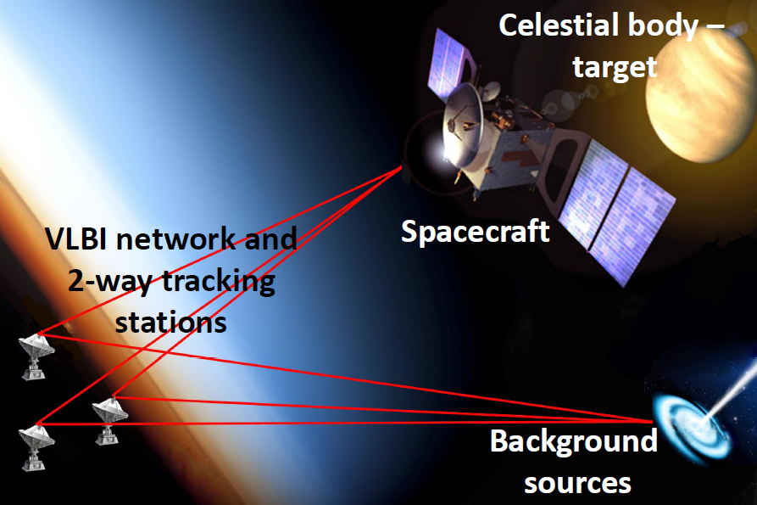
Planetary Radio Interferometry and Doppler Experiment (PRIDE)
Goal:
Provide angular position and radial velocity of S/C to support different scientific experiments.
Method:
Precise Doppler tracking of the S/C carrier signal and near-field VLBI correlation in phase-ref mode.

Slide 3
PRIDE Processing Pipeline
Calibrator data
Spacecraft data
A priori coordinates cal source
A priori S/C state vectors
Calibrator far-field delay model
Spacecraft near-field delay model
SFXC broadband correlation
Residual geocentric
Doppler phase correction
Narrowband processing
Frequency detections
Fringe fitting, residual group delay/ phase estimation
Phase
detections
Phase delay of the S/C signal with resolved 2pi-ambiguity
Reconstruction of the S/C state vectors
Residual group delays/phases

Slide 4
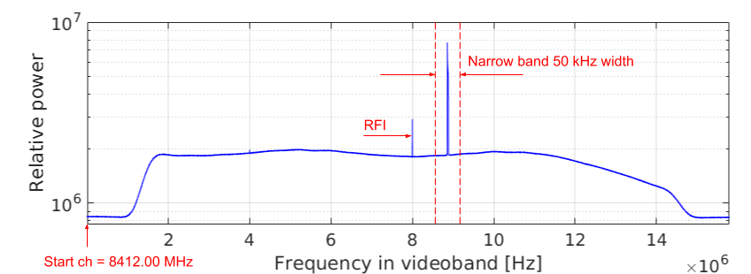
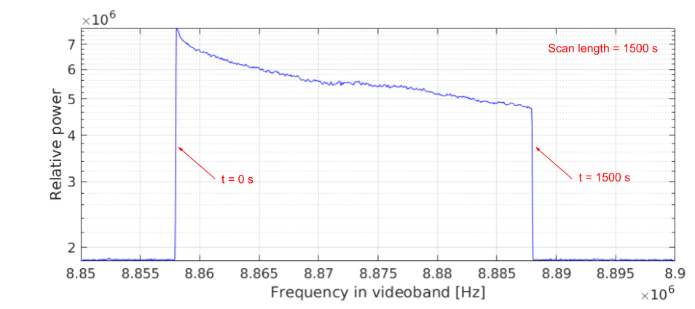
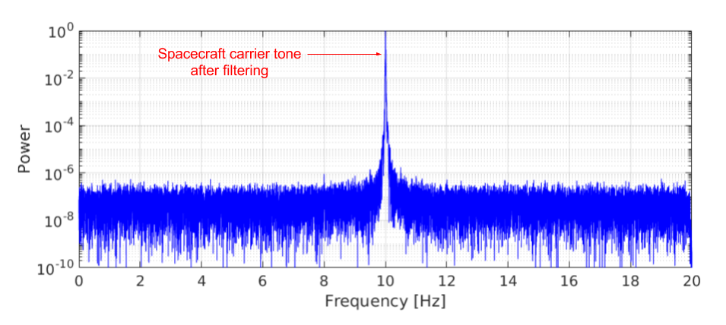
PRIDE Processing Pipeline
Calibrator data
Spacecraft data
A priori coordinates cal source
A priori S/C state vectors
Calibrator far-field delay model
Spacecraft near-field delay model
SFXC broadband correlation
Residual geocentric
Doppler phase correction
Narrowband processing
Frequency detections
Fringe fitting, residual group delay/ phase estimation
Phase
detections
Phase delay of the S/C signal with resolved 2pi-ambiguity
Reconstruction of the S/C state vectors
Residual group delays/phases

Slide 5
PRIDE Processing Pipeline
Calibrator data
Spacecraft data
A priori coordinates cal source
A priori S/C state vectors
Calibrator far-field delay model
Spacecraft near-field delay model
#1
SFXC broadband correlation
Residual geocentric
Doppler phase correction
Narrowband processing
Frequency detections
Fringe fitting, residual group delay/ phase estimation
Phase
detections
Phase delay of the S/C signal with resolved 2pi-ambiguity
Reconstruction of the S/C state vectors
Residual group delays/phases

Slide 6
PRIDE Processing Pipeline
Calibrator data
Spacecraft data
A priori coordinates cal source
A priori S/C state vectors
Calibrator far-field delay model
Spacecraft near-field delay model
SFXC broadband correlation
Residual geocentric
Doppler phase correction
Narrowband processing
Frequency detections
Fringe fitting, residual group delay/ phase estimation
Phase
detections
Phase delay of the S/C signal with resolved 2pi-ambiguity
Reconstruction of the S/C state vectors
Residual group delays/phases

Slide 7
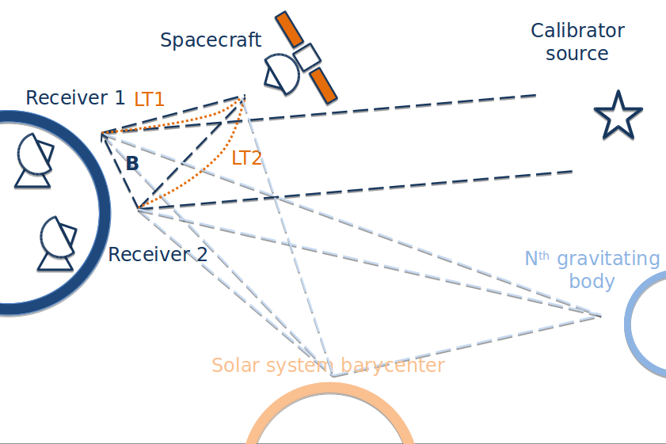
Near-field delay model

Slide 8
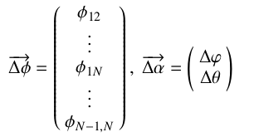
PRIDE Processing Pipeline
Calibrator data
Spacecraft data
A priori coordinates cal source
A priori S/C state vectors
Calibrator far-field delay model
Spacecraft near-field delay model
#1
SFXC broadband correlation
Residual geocentric
Doppler phase correction
Narrowband processing
Frequency detections
Fringe fitting, residual group delay/ phase estimation
#2
Fringe fitting, residual group delay/ phase estimation
Phase
detections
Phase delay of the S/C signal with resolved 2pi-ambiguity
Phase delay of the S/C signal with resolved 2pi-ambiguity
Reconstruction of the S/C state vectors
Reconstruction of the S/C state vectors
Residual group delays/phases
Residual group delays/phases

Slide 9
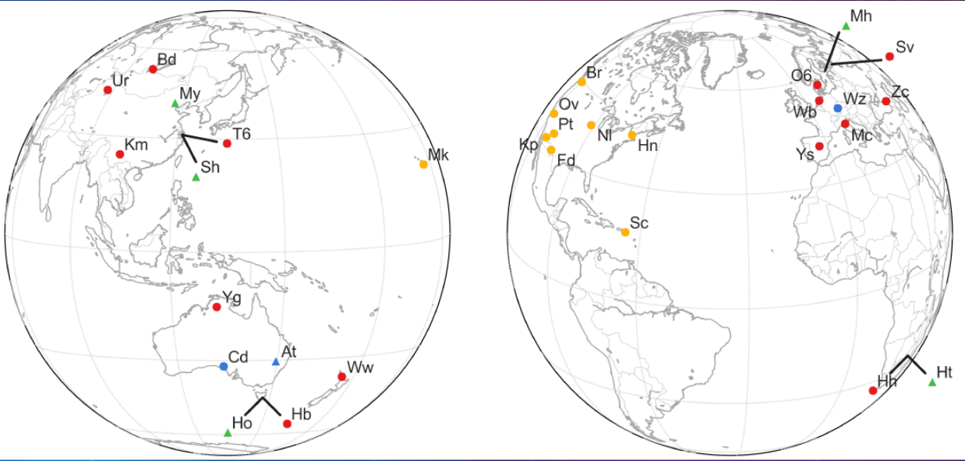
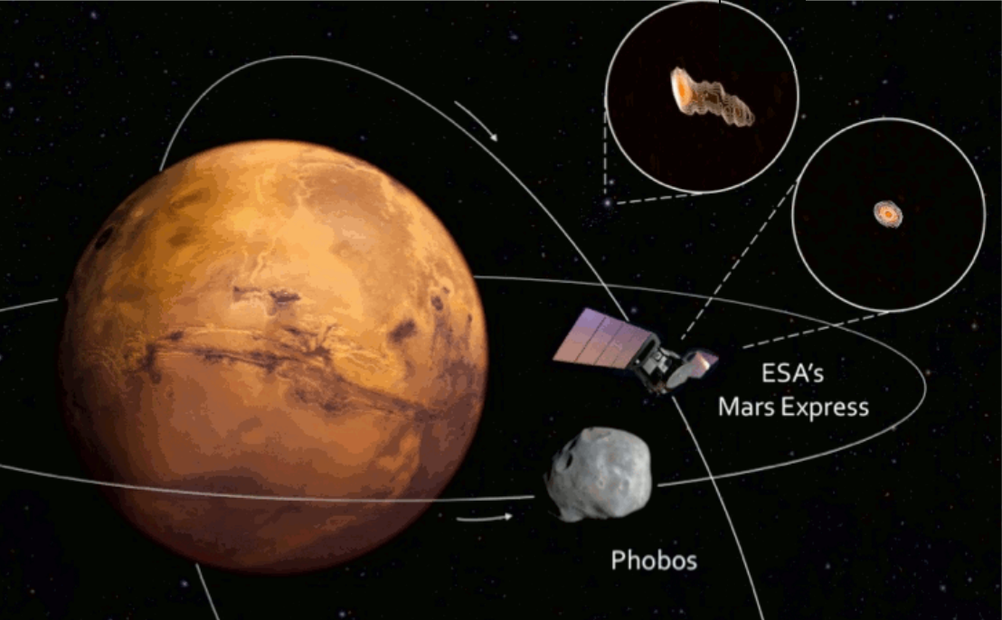
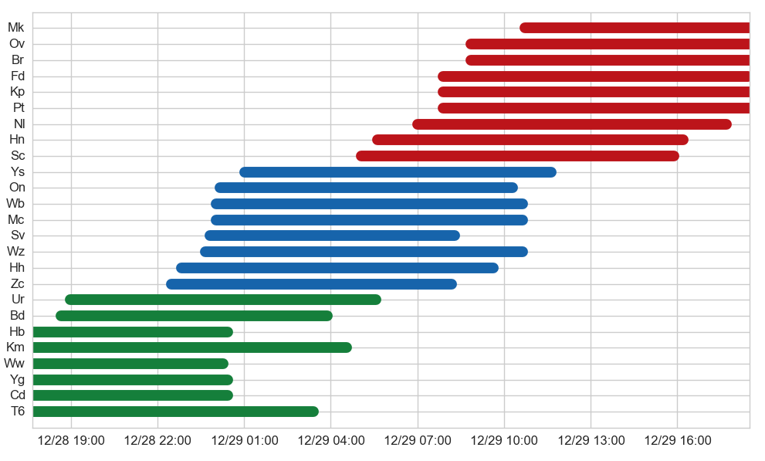
GR035

Slide 10
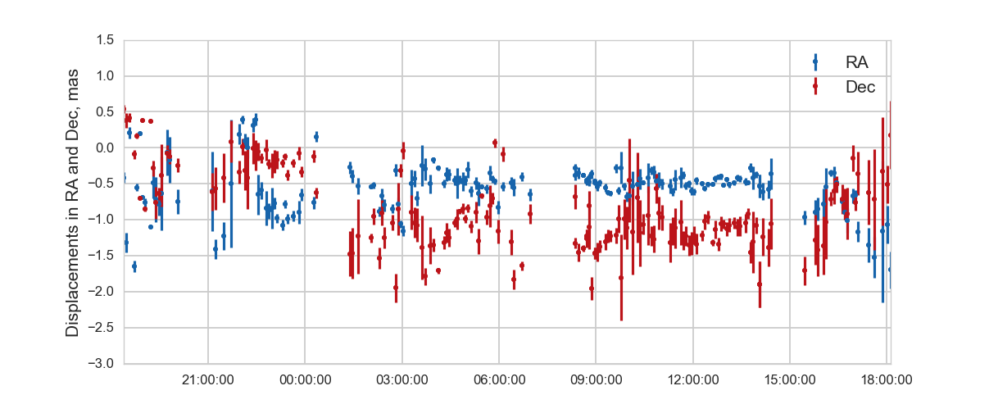
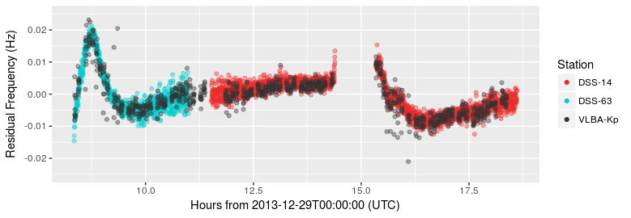
GR035
Duev et al., 2016
Displacement between measured and predicted
MEX celestial position:
Formal precision (3σ):
RA 34 μas 35 m
Dec 58 μas 60 m
Bocanegra-Bahamon et al., 2017
Doppler spectral resolution of ~2 mHz, linear measure 30 μm/s

Slide 11
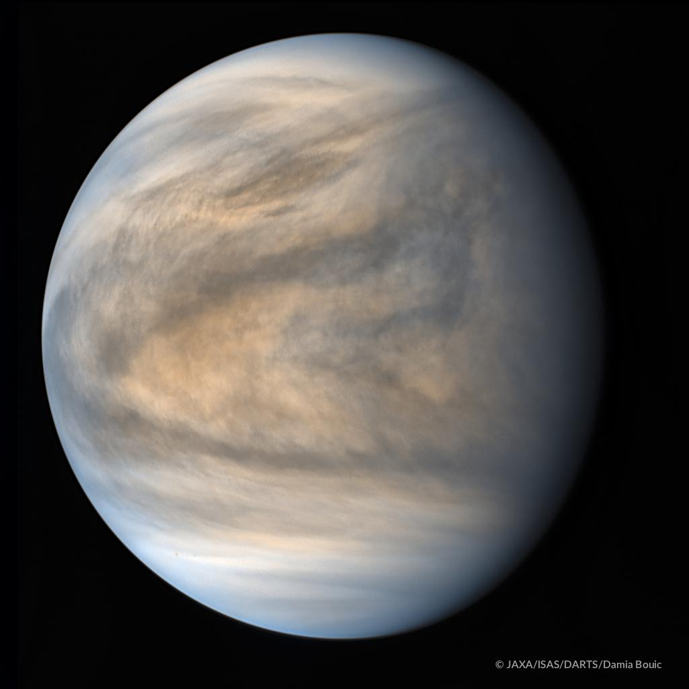
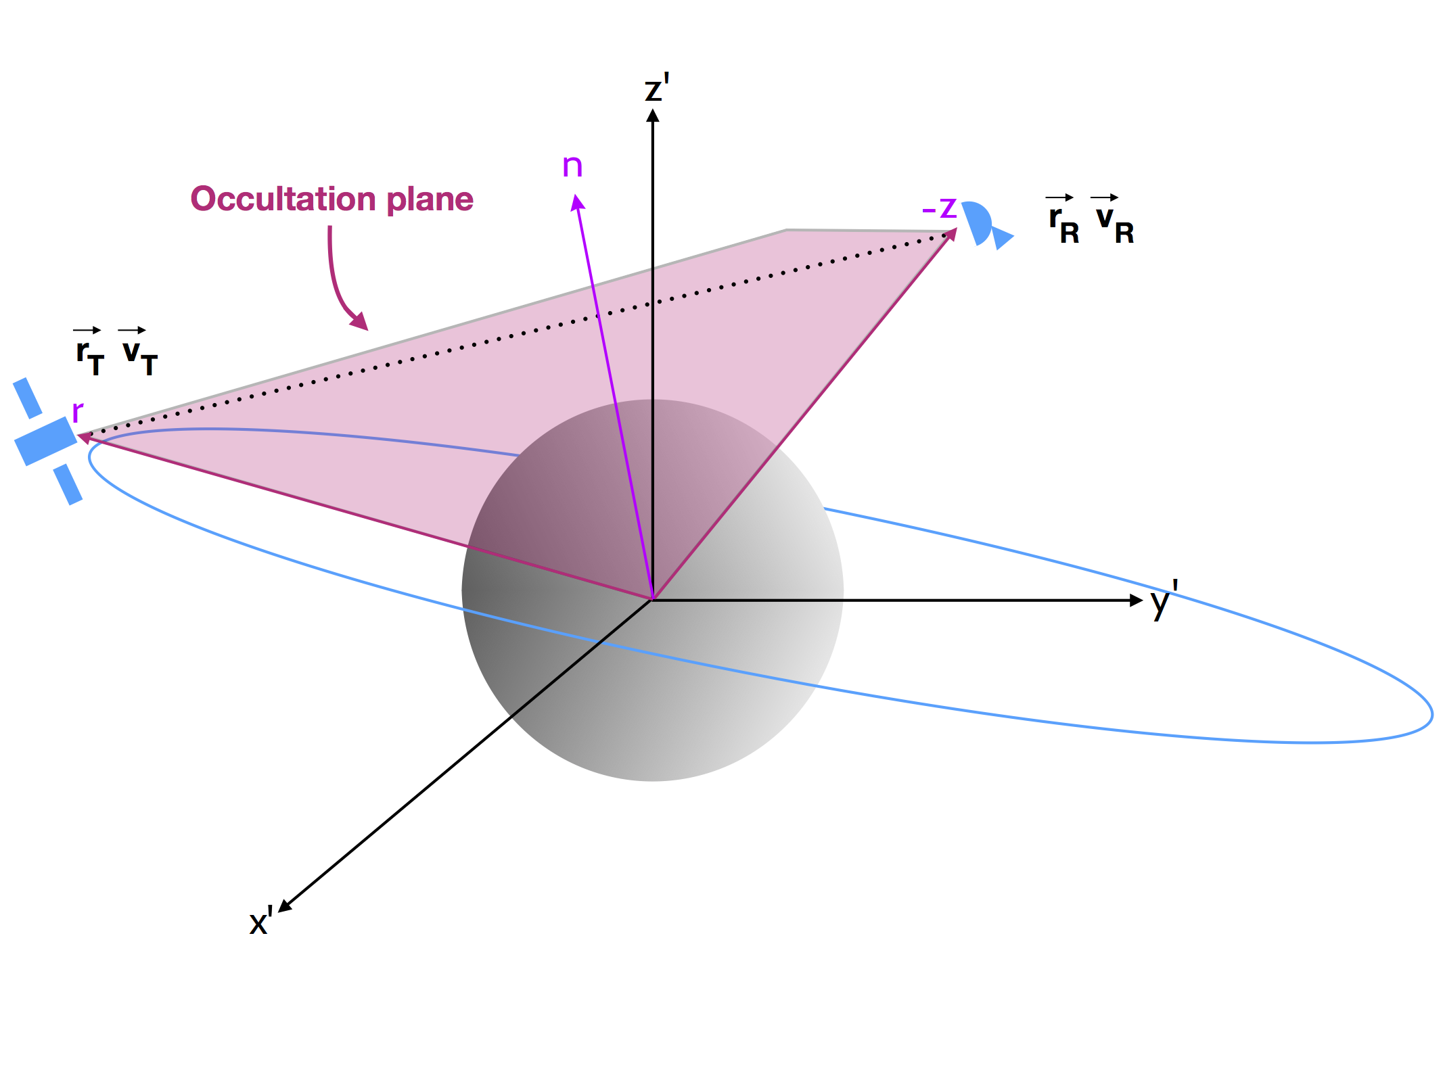
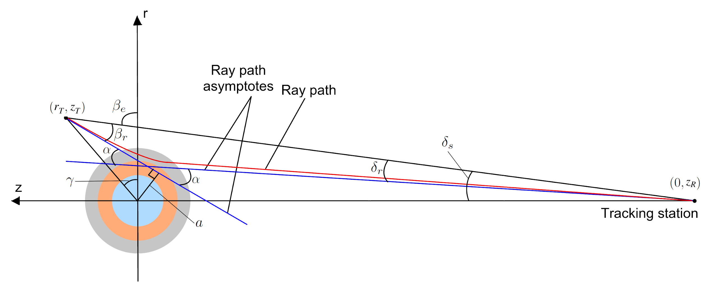
PRIDE for
planetary
atmospheric
studies

Slide 12
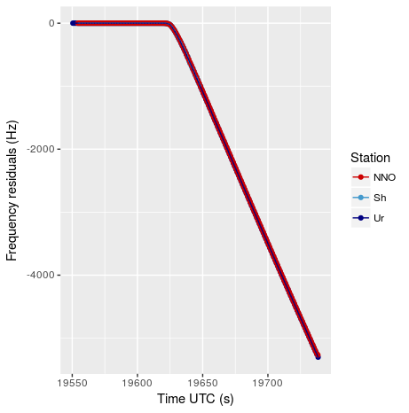
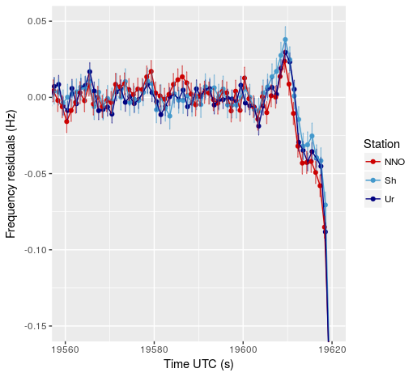
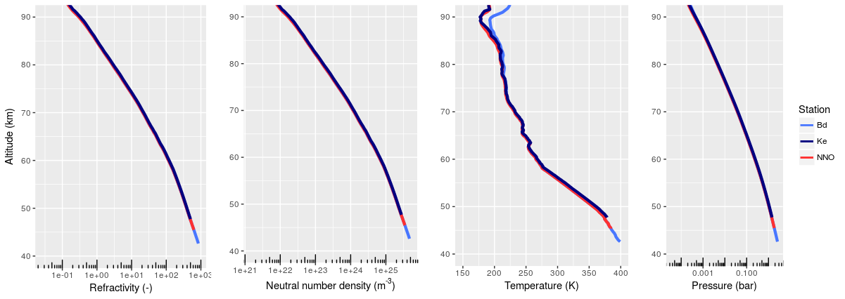
Characterization of Venus’ neutral atmosphere
Bocanegra-Bahamon et al., 2018

Slide 13
JUpiter ICy-moons Explorer (JUICE)

Slide 14
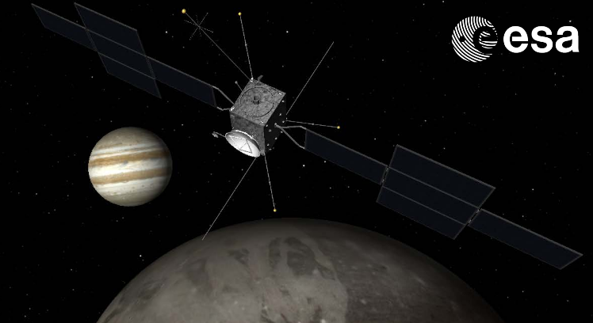
PRIDE-JUICE science deliverables
S/C differential lateral position with the accuracy of 100-10 μas with an integration time 60-1000s -> Ephemerides of the Jovian system.
Doppler range rate measurement with an accuracy of 0.015 mm/s at 60s integration time.
Measurements of the occultation of the radio signal for characterization of Jupiter’s ionosphere and neutral atmosphere, and exospheres of moons.

Slide 15
Summary
The precision of PRIDE observables is comparable to that of the deep space networks for radio science applications.
PRIDE is “ready-to-use” technique, that can be used for experiments with any planetary spacecraft.
Planetary scientists as potential new users of the EVN.
JIVE and EVN will be involved through PRIDE in the upcoming ESA JUICE mission to the Jovian system.

Slide 16
Gracias!
This presentation has received funding from the European Union’s Horizon 2020 research and innovation programme under grant agreement No 730562 [RadioNet]
T.M. Bocanegra Bahamon, L.I. Gurvits, G. Cimo, G. Molera Calves, D.A. Duev and S. Pogrebenko

Slide 17
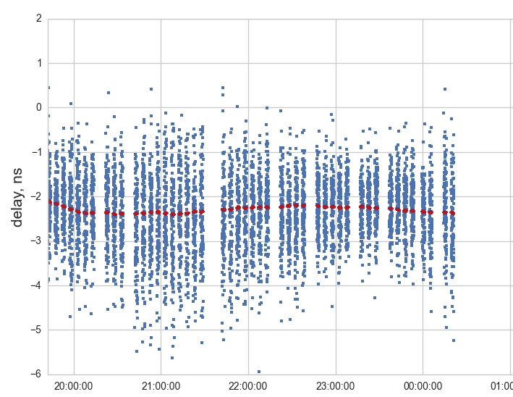
T.M. Bocanegra Bahamon, L.I. Gurvits, G. Cimo, G. Molera Calves, D.A. Duev and S. Pogrebenko

Slide 18
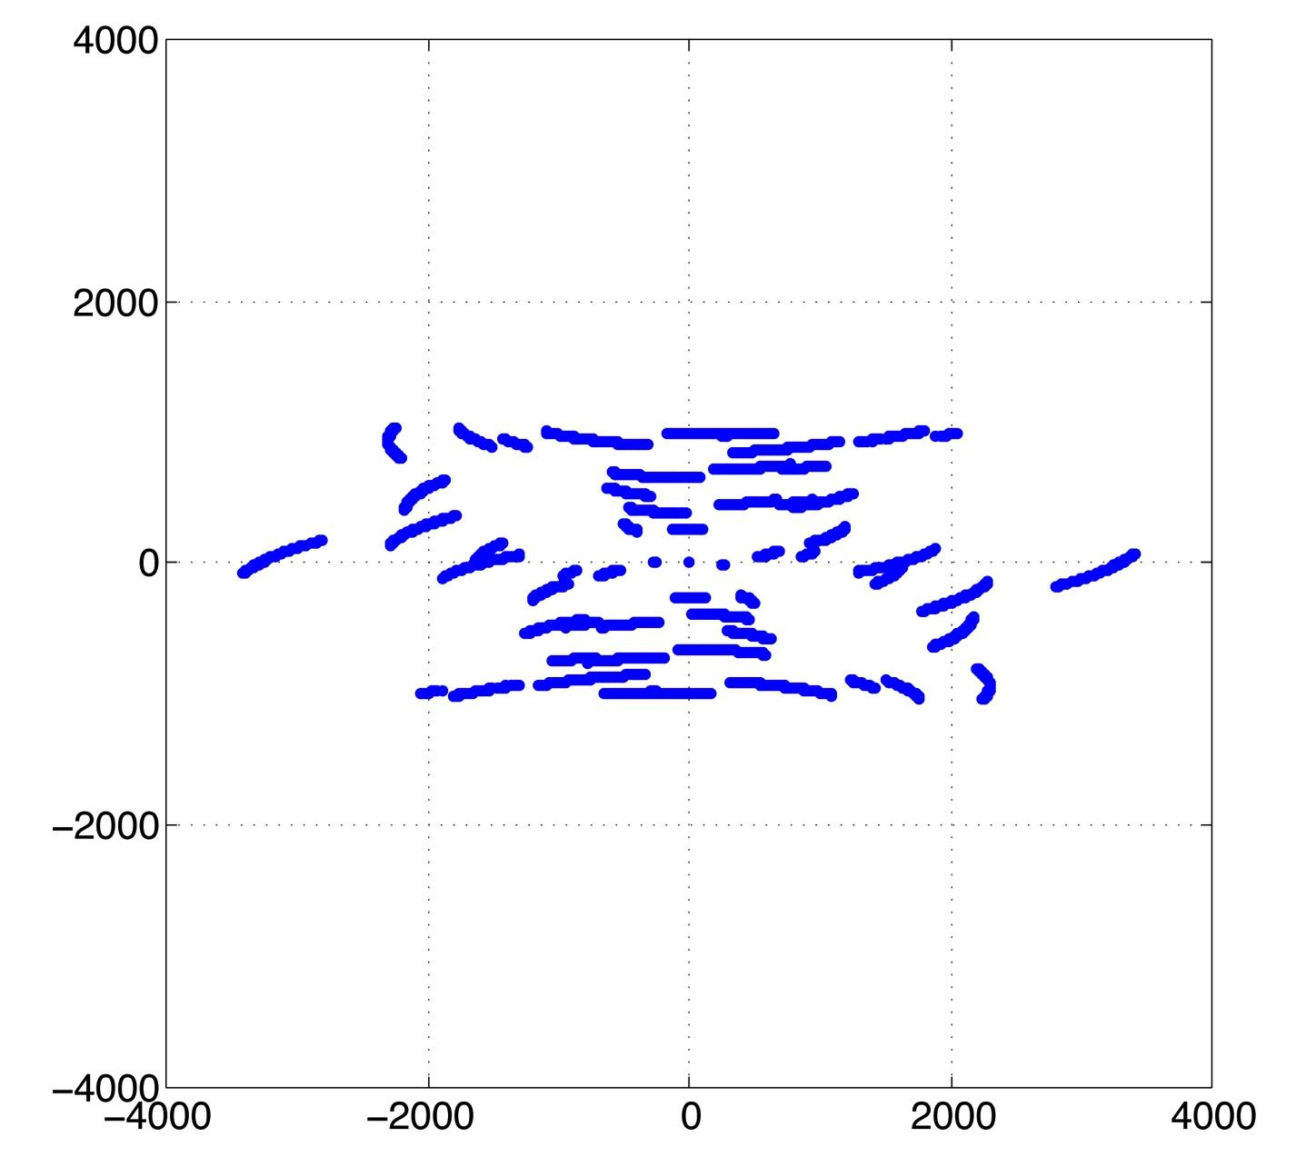
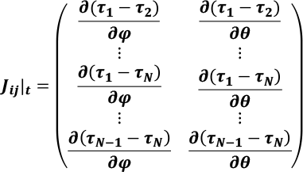
Near-field delay model
Traditional «uv»-projections
of baselines
Elements of the Jacobian
for the near-field VLBI case

Slide 19
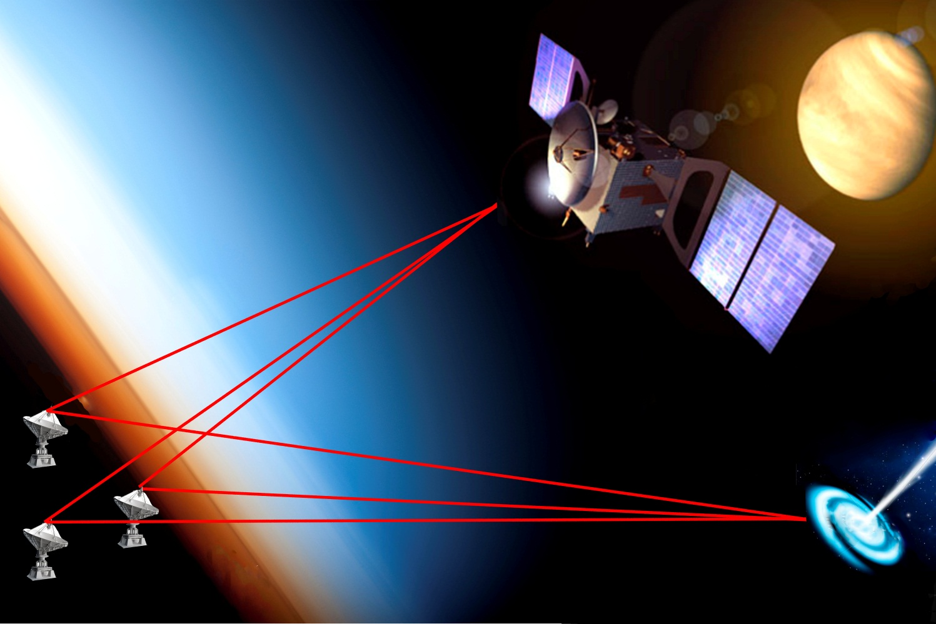
Planetary Radio Interferometry and Doppler Experiment (PRIDE)
Goal:
Provide angular position and radial velocity of S/C to support different scientific experiments.
Method:
Precise Doppler tracking of the S/C carrier signal and near-field VLBI correlation in phase-ref mode.

Slide 20
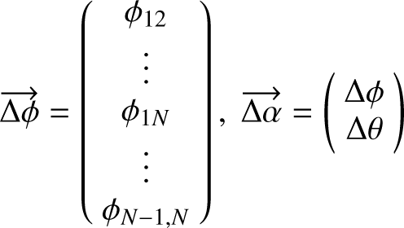
PRIDE Processing Pipeline
Calibrator data
Spacecraft data
A priori coordinates cal source
A priori S/C state vectors
Calibrator far-field delay model
Spacecraft near-field delay model
#1
SFXC broadband correlation
Residual geocentric
Doppler phase correction
Narrowband processing
Frequency detections
Fringe fitting, residual group delay/ phase estimation
#2
Fringe fitting, residual group delay/ phase estimation
Phase
detections
Phase delay of the S/C signal with resolved 2pi-ambiguity
Phase delay of the S/C signal with resolved 2pi-ambiguity
Reconstruction of the S/C state vectors
Reconstruction of the S/C state vectors
Residual group delays/phases
Residual group delays/phases

Slide 21
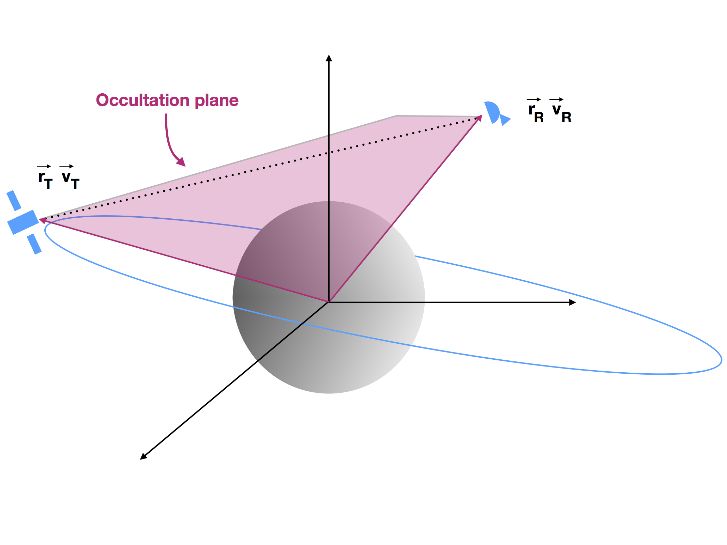
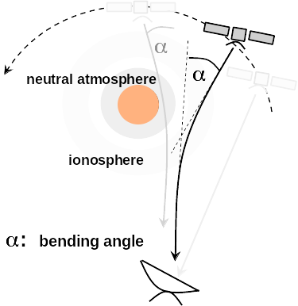

Slide 22
