Slide 1




Measuring magnetic fields in the synchrotron protostellar jet in W3(H₂O)
Ciriaco Goddi
IMAPP, Radboud University, Nijmegen, Netherlands
Allegro, ALMA ARC node, Leiden Observatory, Netherlands
More info at:
C. Goddi, G. Surcis, L. Moscadelli, H. Imai, W. H. T. Vlemmings, H. J. van Langevelde, and A. Sanna, A&A, 597, A43 (2017)

Slide 2
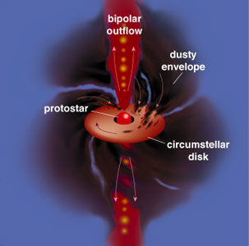
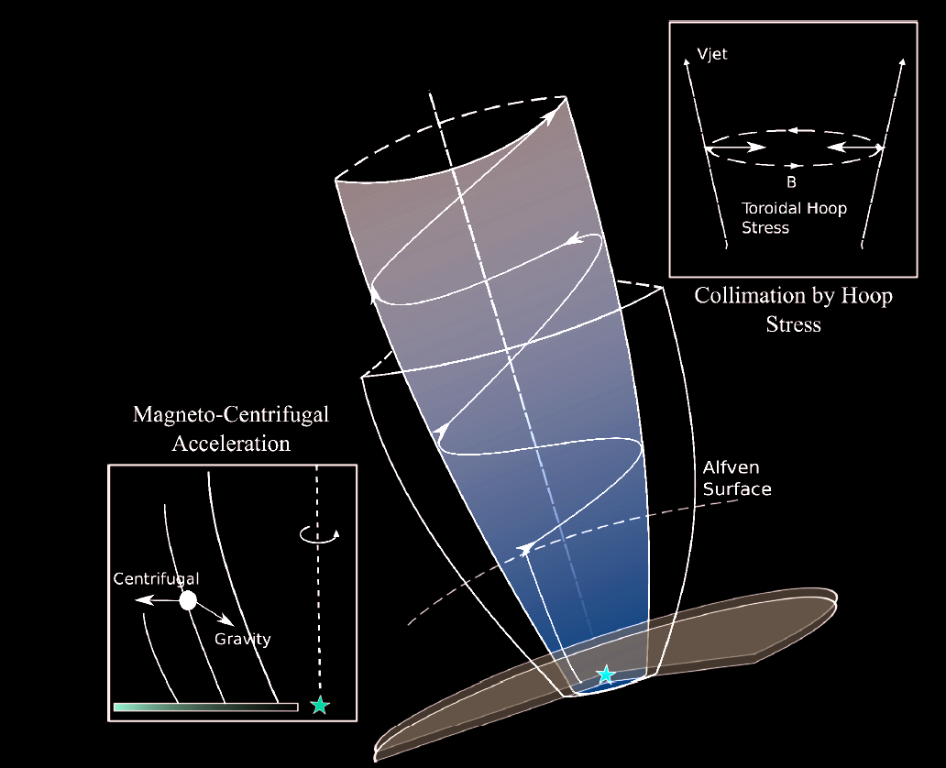
Role of Magnetic fields in jet launch
Magnetic fields are invoked to launch, drive, and shape protostellar jets.
Observational data on the spatial scales required to assess their role in the mass-loss process is scarce.
Adapted from Blandford & Payne 1982
(Mildly) relativistic electrons gyrating in magnetic fields along protostellar jets can produce synchrotron emission

Slide 3
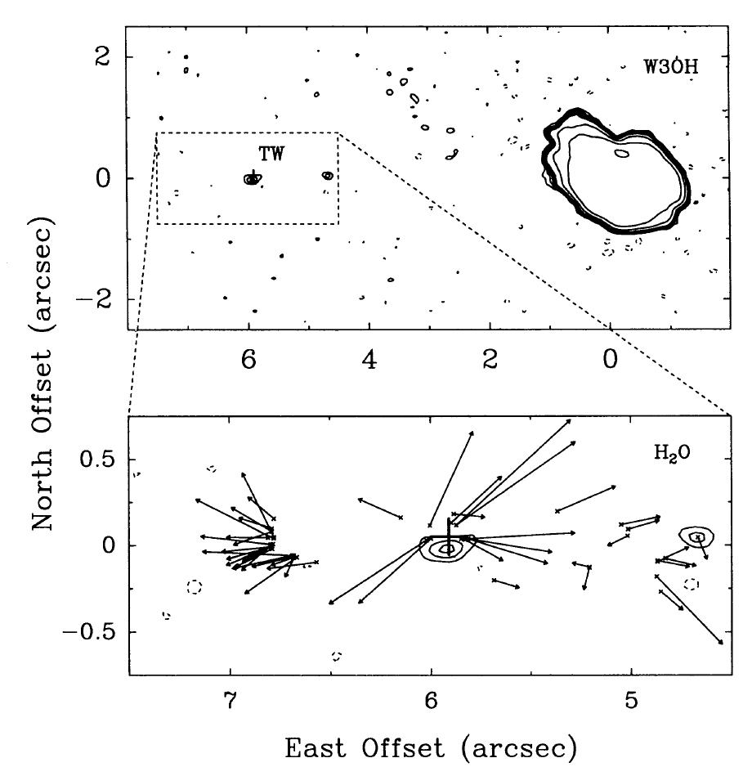
The target:
Turner-Welch (TW) Object in the W3(OH)
synchrotron jet from a high-mass protostar
  B must play a role in driving this jet
strongly polarized H₂O maser source
  VLBI can be used to map B at the highest angular resolution
Reid et al. 1995
Optimal target to investigate the role of magnetic fields on the innermost scales of protostellar disk/jet systems.

Slide 4
Observations
Full-polarimetric observations of the 22 GHz H₂O maser line with the VLBA
Transition: 6₁₆-5₂₃ of H₂O (rest freq: 22.2 GHz)
Array: NRAO Very Long Baseline Array (VLBA)
Date: August 18th 2006; Observation time : 12 h.
Spectral setup: BW=2 MHz, Dv≈ 27 km/s.
Three correlation passes:
128 channels, Dv=15.6 kHz (0.2 km/s) and full polarization: RR, LL, RL, LR (used to measure linear polarization)
1024 channels, Dv=1.95 kHz (0.03 km/s), polarization: RR
1024 channels, Dv=1.95 kHz (0.03 km/s), polarization: LL (used to measure circular polarization or Zeeman splitting)
Notes:
picture

Slide 5
Observations and data analysis
Linear polarization:
Velocity cubes: Stokes I, Q, U (Dv=0.2 km/s)
Polarized intensity: POLI = sqrt(􏰆Q² + U²)
Polarization angle: POLA = 1/2 × atan(U/Q))
  B-orientation:
  B_{sky} = POLA (±90º) (Goldreich 1973)
Circular polarization (Zeeman splitting):
Velocity cubes: Stokes I and V (Dv=0.03 km/s)
Circular polarization fraction: P_{V} = (V_{max} − V_{min})/I_{max}
  B-strength: B[Gauss]=P_{v} ΔV[km/s] / α cosθ

Slide 6
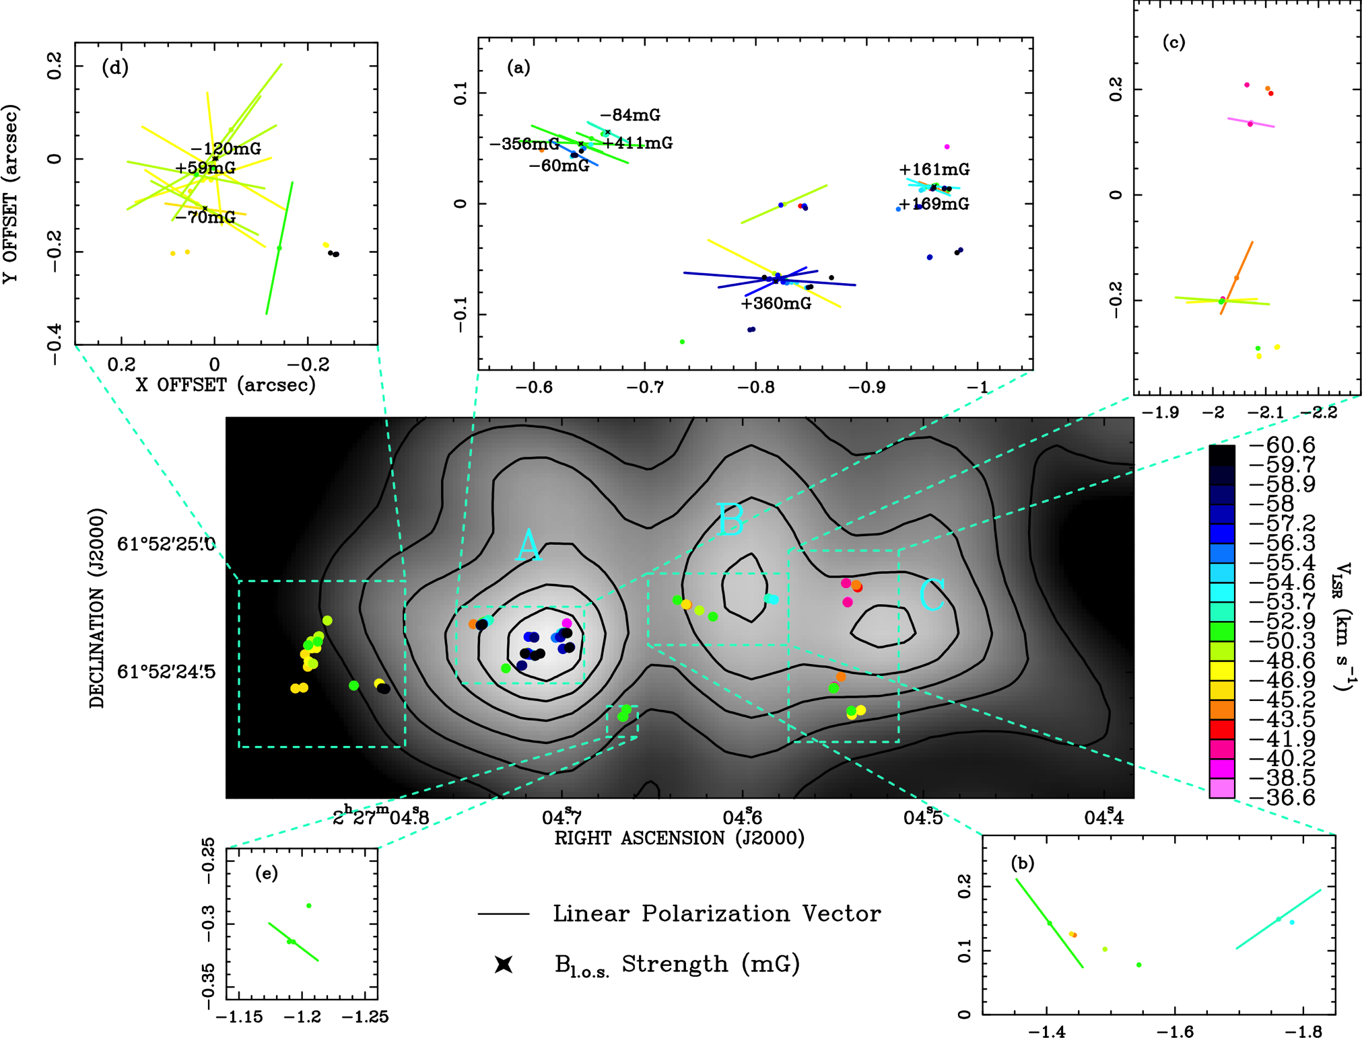
I. Measurements of the linear and circular polarization of H₂O masers towards W3(H₂O) with the VLBA
148 masers
40 polarized
P_{l}=1-40%
P_{V} = 0.2-1.6%

Slide 7
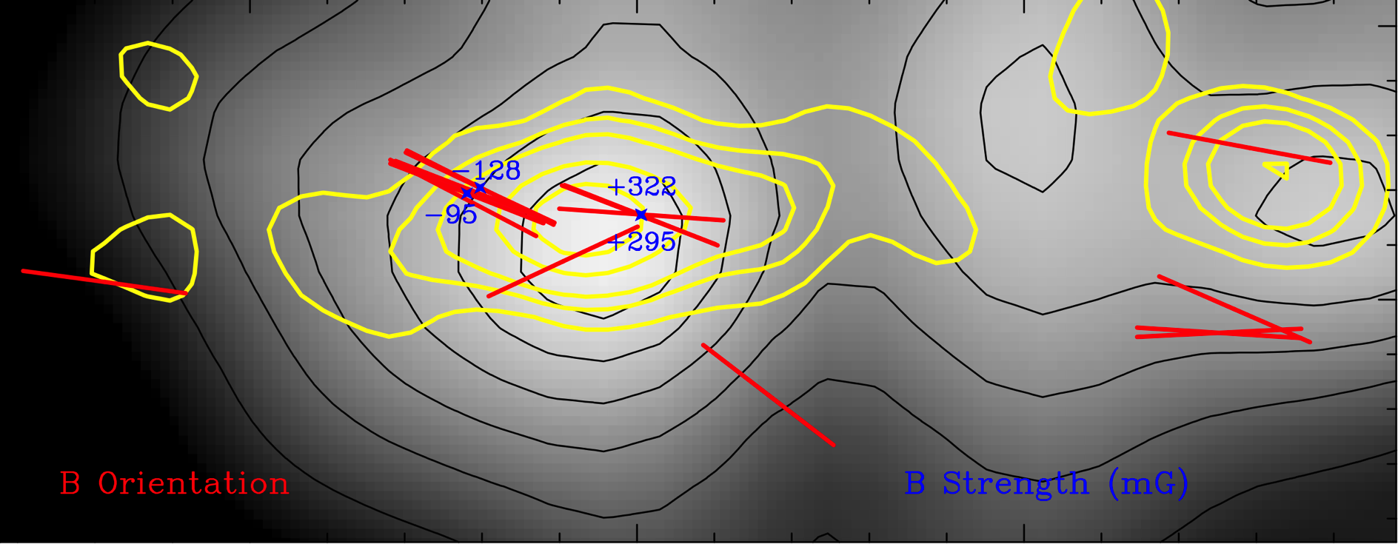
II. Measurements of the Magnetic Field
The linearly polarized emission of H₂O masers provides clues on the orientation of the local magnetic field (on the plane of the sky), while measurement of the Zeeman splitting provides its strength (along the L.O.S.)
Jet Axis
1000 AU
(Including only masers with Pl<5%)
B~100-300 mG
Notes:
Fig. 2. Magnetic field orientation (in the plane of the sky) for 17 individual masers with Pl < 5% (red segment) and strength for 4 (non-saturated) masers for which the Zeeman splitting was measured. The features with Pl > 5% were not included in the analysis because saturated. The 8.4 GHz emission imaged with the VLA (beamsize∼0.2”) by Wilner et al. (1999) is overploted onto the 1.4 mm continuum emission mapped with the PdBI (beamsize∼0.5”) by Wyrowski et al. (1999) (gray scale and black contours: same as in Fig. 1). The radio continuum shows a main central component, the synchrotron jet, and two (western and eastern) secondary components.

Slide 8
What’s the origin of such a strong magnetic field?
H₂O masers emerge behind shocks
B parallel to the shock front is compressed
B perpendicular to the shock front is unaffected
B post-shock
Shock front
B pre-shock
B post-shock
Shock front
B pre-shock
In a shock, one can decompose B in a component parallel (B||) and perpendicular (B⊥) to the shock velocity:
B_{0⊥}
B⊥
B||
B_{0||}
Shock front

Slide 9
What’s the origin of such a strong magnetic field?
H₂O masers emerge behind shocks
B_{0⊥}
B⊥
(n_{s} = post-shock density;
n₀ = pre-shock density;
0 indicates pre-shock regions)
B||
B_{0||}
Shock front
B|| = B_{0|| ,} B⊥ = B_{0⊥} n_{s}/n₀
For n₀ = 10⁷ cm⁻³, n_{s} = 10⁹ cm⁻³
(Wyrowski et al. 1999; Eliztur 1989)
B⊥ = 100-300 mG
B_{0⊥} = 1-3 mG
B_{0||}?

Slide 10
III. Gas dynamics and magnetic field structure
Jet Axis
1000 AU
Notes:
Fig. 2. Magnetic field orientation (in the plane of the sky) for 17 individual masers with Pl < 5% (red segment) and strength for 4 (non-saturated) masers for which the Zeeman splitting was measured. The features with Pl > 5% were not included in the analysis because saturated. The 8.4 GHz emission imaged with the VLA (beamsize∼0.2”) by Wilner et al. (1999) is overploted onto the 1.4 mm continuum emission mapped with the PdBI (beamsize∼0.5”) by Wyrowski et al. (1999) (gray scale and black contours: same as in Fig. 1). The radio continuum shows a main central component, the synchrotron jet, and two (western and eastern) secondary components.

Slide 11
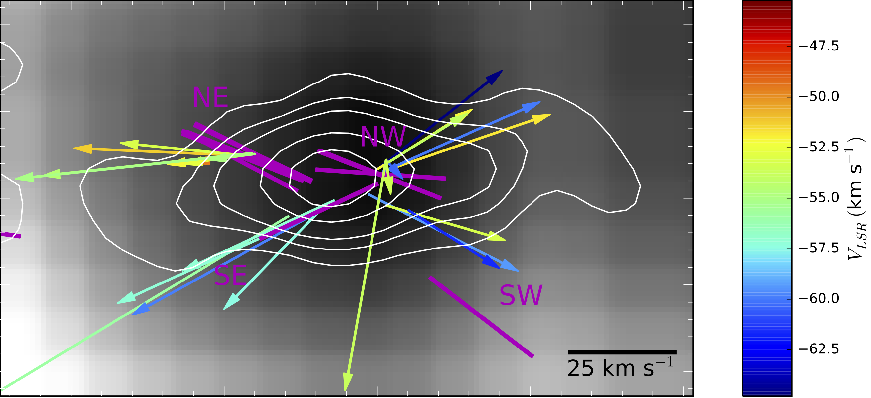
III. Gas dynamics and magnetic field structure
(From a VLBA multi-epoch proper motion study - Hackisuka et al. 2006)
The magnetic field and the velocity vectors are apparently misaligned
Notes:
On small scales of 10s to 100s of AU, we reveal a misalignment between the magnetic field and the velocity vectors, which trace a bipolar, biconical outflow at the center of the synchrotron jet.

Slide 12
What’s the origin of such a misalignment?
Behind shocks : B ⊥V
Φ_{th} = 90º
Φ_{obs} < 90º?

Slide 13
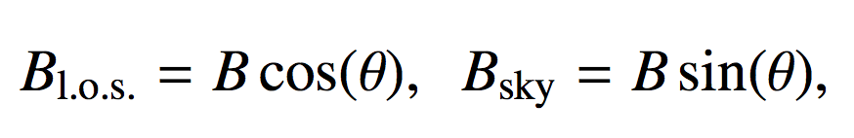
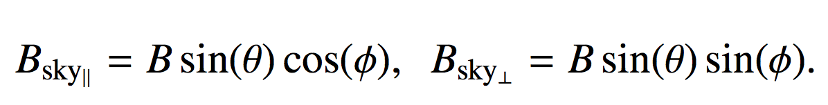
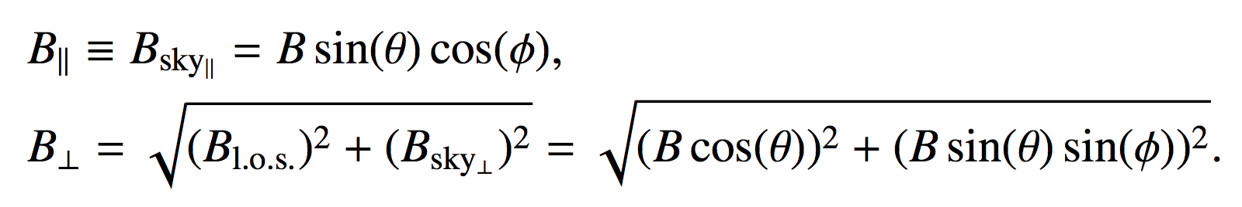
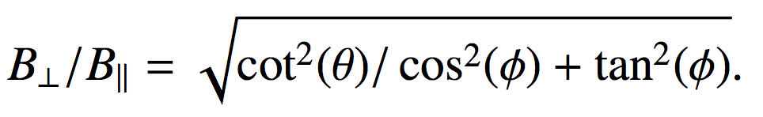
……..possibly 3-D effects…..
B⊥ /B|| ~ 10 =➔ Φ_{3d} ~85º
B|| = B_{0||}=10-30 mG
B⊥ = 100-300 mG => B||~10-30mG

Slide 14
Conclusions
In the pre-shock gas, the magnetic field starts with a dominant component parallel to the outflow velocity.
B_{0⊥} = 1-3 mG ; B_{0||}=10-30 mG
In the post-shock gas, it becomes mainly dominated by the component perpendicular to the shock velocity.
B⊥ = 100-300 mG ; B||=10-30 mG
Main Implication:
Magnetic fields can be dynamical important in
driving the gas outflowing from a high-mass protostar.
More info at:
C. Goddi, G. Surcis, L. Moscadelli, H. Imai, W. H. T. Vlemmings, H. J. van Langevelde, and A. Sanna, A&A, 597, A43 (2017)

